Slide 1
Judicial Seminar
August 16, 2023 12:15 p.m. – 1:00 p.m.
Notes:
BREN’S SLIDE:
Good afternoon! Thank you for joining us today…I realize we have limited time to share a great deal of information, so I’ll get started.
First, I’d like to introduce a few ROV staff members:
From our Executive Division we have in attendance today
Shannon Bushey, our Registrar of Voters
Virginia Bloom, our Assistant Registrar of Voters
and Matt Moreles, our other Assistant Registrar of Voters
From our Candidate Services Division we have in attendance, myself
Bren Lehr, Election Division Coordinator
Claudia Gonzalez, Interim Election Process Supervisor
and Louella Sevegan, Marianna Khienkina, and Cassandra Hevia, Election Specialists
County Counsel staff also in attendance are
Deputy County Counsels Mary Hanna Weir and Nick DeFiesta

Slide 2
Agenda
Signature-in-Lieu Period
Declaration of Intention Period
Nomination Period
Nomination Paper
Declaration of Candidacy
Candidate Statement of Qualifications
Ballot Designation Worksheet
Other Nomination Documents
Write-in Petition
ROV Contacts
Questions & Answers
Candidate Information Request Form
Preferred Transliteration Form
Vietnamese Name Accents Form
Code of Fair Campaign Practices Form
Department of Transportation – Statement of Responsibility
FPPC Form 501 and Form 700
Notes:
BREN’S SLIDE:
On this slide you’ll find our agenda for today’s presentation. In the following slides, we’ll be sharing information related to the Signature-in-Lieu Period, Declaration of Intention Period, Nomination Period, Write-in Petition process, and go over other nomination documents to be submitted during the nomination period, as well as your ROV contacts, and then we’ll wrap-up with last minute questions and answers.
As a reminder, when filing your documents at the ROV’s office during the Declaration of Intention and Nomination Periods, please be sure to use only the forms issued by the Registrar of Voters office. Forms printed from other websites like the Secretary of State will not be accepted.
Between each section of the presentation, we’ll prompt for questions; however, to keep the presentation flowing smoothly during our limited time together, we ask that you hold questions until the end of today’s presentation. Myself and other CSD staff will also be checking for questions in chat, and we’ll address them as quickly as possible.

Slide 3
Calendar of Dates
Important dates to remember… NOTE: November 7, 2023 Special Election activities occurring simultaneously…
Signature-in-Lieu (SIL) Period | September 14, 2023 – November 8, 2023 (optional period)
Declaration of Intention (DOI) Period | October 30, 2023– November 8, 2023
Declaration of Intention (DOI) Extension Period | November 9, 2023– November 13, 2023
Nomination Period | November 13, 2023 – December 8, 2023
FPPC 1st Pre-Election Statements Due | January 25, 2024 for reporting period: January 1, 2024 to January 20, 2024 or the day after the closing date of the last statement filed.
FPPC 2nd Pre-Election Statements Due | February 22, 2024 for reporting period: January 21, 2024 to February 17, 2024 or the day after the closing date of the last statement filed.
Election Day-Presidential Primary Election | March 5, 2024
Official Canvass of Vote / Certification of Election Results | April 4, 2024
FPPC Semi-Annual Statements Due | July 31, 2024 for reporting period: January 1, 2024 - June 30, 2024 or the day after the closing date of the last statement filed.
Notes:
BREN’S SLIDE:
Moving on to our calendar of important dates to remember.
Before I begin sharing information, I’d like to point out that during the March 5, 2024 Presidential Primary Election activities, we are also finalizing our November 7, 2023 Special Election activities. This includes the Write-in Candidacy Period between September 11 through October 24, and early voting between October 28 through November 6; therefore, you may see voters in our office or at Vote Centers picking up and dropping off ballots for that election too.
The signature-in-lieu period for the March 5, 2024 Presidential Primary election begins September 14 and ends November 8 – this is an optional period for a candidate to submit signatures of valid registered voters to offset their filing fee.
The Declaration of Intention period begins October 30 and ends November 8 – it’s important to remember to please file your Declaration of Intention form AND the Sworn Statement of Qualifications form on or before November 8 by 5:00 p.m. If the Registrar of Voters office does not receive your forms by end of the Declaration of Intention period, you will be unable to file the necessary documents during the nominations period and you will not be eligible to qualify as a candidate.
The Declaration of Intention extension period begins November 9 and ends November 13 – during this period, any candidate other than the incumbent can file a Declaration of Intension form and Sworn Statement of Qualifications form.
The Nomination Period begins November 13 and ends December 8 – during this period, you’ll file all other required nomination documents to qualify as a candidate.
If you intend to campaign and raise funds in efforts of your candidacy, along with any semi-annual statement periods, there will be two FPPC pre-election statement due dates: 1st due date is January 25 for the reporting period January 1 through January 20 or the day after the closing date of the last statement filed; the 2nd due date is February 22 for reporting period January 21 through February 17 or the day after the closing date of the last statement filed. Additionally, if you have an open campaign committee then you’ll also have a semi-annual statement due on July 31 for reporting period January 1 through June 30 or the day after the closing date of the last statement filed.
Election day is March 5, 2024.
The official canvass of votes and certification of election results will be held on April 4.
Please keep in mind that judicial seats remain off-ballot for both the direct primary and general elections unless a candidate other than the incumbent files nomination paperwork during the regular nomination period or the extension period, or if a qualified petition is filed with the ROV that forces a judge’s name to either the direct primary election or the general election to allow for a write-in campaign. We’ll speak more about this in the coming slides.

Slide 4
Useful Resources
March 5, 2024 Presidential Primary Election Resources Webpage
March 5, 2024 Presidential Primary Candidate Guide
Abbreviated Calendar
FPPC Campaign Manual 2
State of California Elections Codes
Notes:
BREN’S SLIDE:
On this slide are links to useful resources.
The March 5, 2024 Presidential Primary Election Resources webpage includes information such as:
Lists of Unofficial or Qualified Candidates, including Write-in Candidates and Candidates who have pulled Signatures in-lieu Forms;
An abbreviated calendar of all important dates to remember throughout the election cycle;
Certain candidate forms that can be released to the public prior to the nominations period;
The candidate guide, and,
Other links to resource webpages such as the Fair Political Practices Commission and the State of California Elections Codes websites.

Slide 5
This Photo by Unknown Author is licensed under CC BY-SA
Notes:
BREN’S SLIDE:
At this point, I’d like to check if there are any questions? And if none, then I’ll begin sharing information related to the Signature-in-Lieu and Declaration of Intensions Periods.

Slide 6
Signature-in-Lieu Period
September 14, 2023 to November 8, 2023
Notes:
BREN’s Slide:
We’ll now discuss in more detail the Signature-in-Lieu period…

Slide 7
Signature-in-Lieu and Candidate Filing Fee
 | Salary (as of 7/1/22) | Filing Fee (1% of Salary) | SILs to Collect | SIL Value | Nomination Signature Requirement
56-day SIL | $232,399.00 | $2,323.99 | 6,972 | $0.33333 | 20 (40)
Signatures collected during the Signature-in-Lieu period can be used towards offsetting the filing fee of $2,323.99 (calculated at 1% of the $232,299.00 salary effective on 7/1/23 thru 6/30/24)
Signature value: $0.33333 (per signature)
6,972 number of signatures is needed to offset the entire filing fee
SIL signatures shall also be applied towards the required 20 nomination signatures
SIL signatures do not have to be filed at one time but is recommended
Notes:
bren’s Slide:
As mentioned earlier, the Signature in Lieu (SIL) period opens at 8:00 a.m. on Thursday, September 14, 2023 and ends on Wednesday, November 8, 2023 at 5:00 p.m. This is an optional period that will allow candidates to collect signatures to offset their candidate filing fee.
The candidate filing fee is calculated at 1% of the Judge of the Superior Court current salary of $232,399.00 which is effective through June 30, 2024.
If candidates desire to offset their entire filing fee of $2,323.99, they will need to collect a total of 6,972 signatures of valid registered voters.
SIL signatures shall also be applied toward the required 20 signatures needed during the nomination period.
SIL signatures do not need to be filed all at once but can be submitted throughout the signature-in-lieu period. Candidates can bring in petitions on different days during the SIL period and we’ll check the signatures as soon as possible and get back to you in a timely manner to ensure you stay updated on the number of valid signatures collected during the SIL period. However, the ROV does recommend you submit as many signatures as possible, and at the same time, to ensure you meet the requirement of collecting enough signatures in a timely manner prior to the deadline to submit, that is your goal.

Slide 8
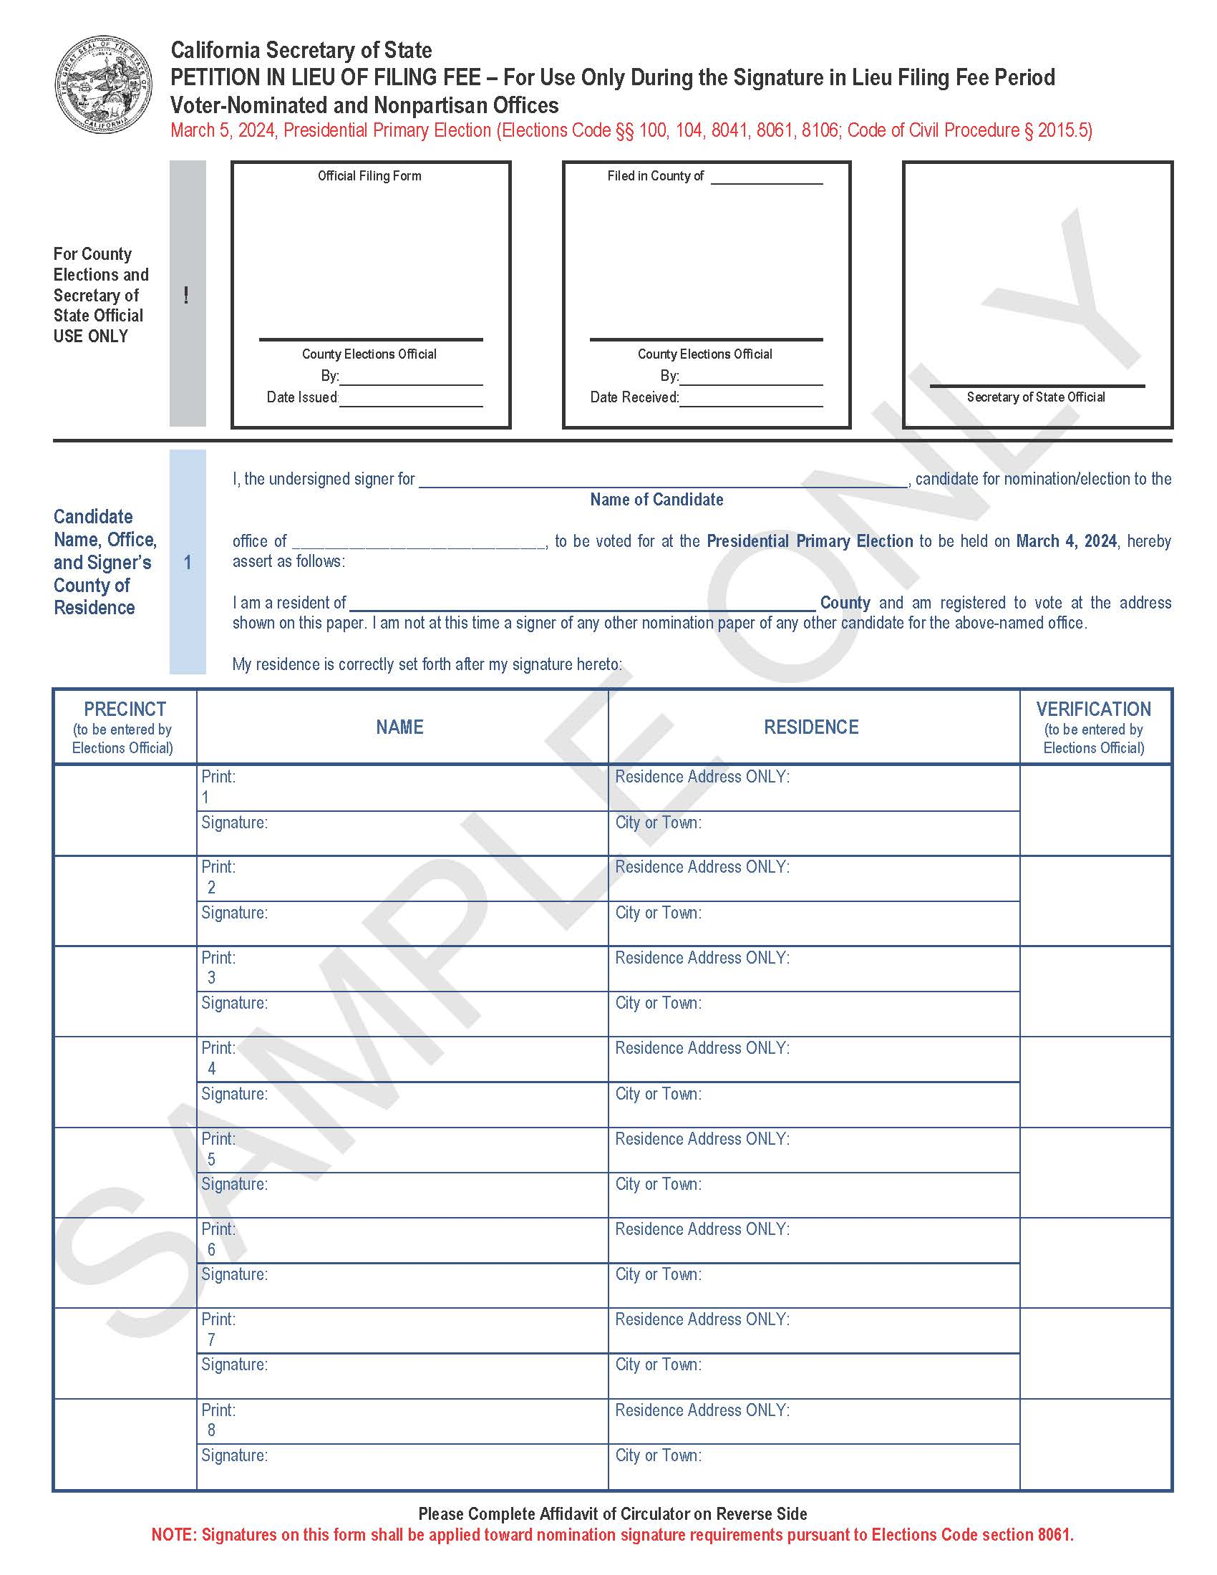
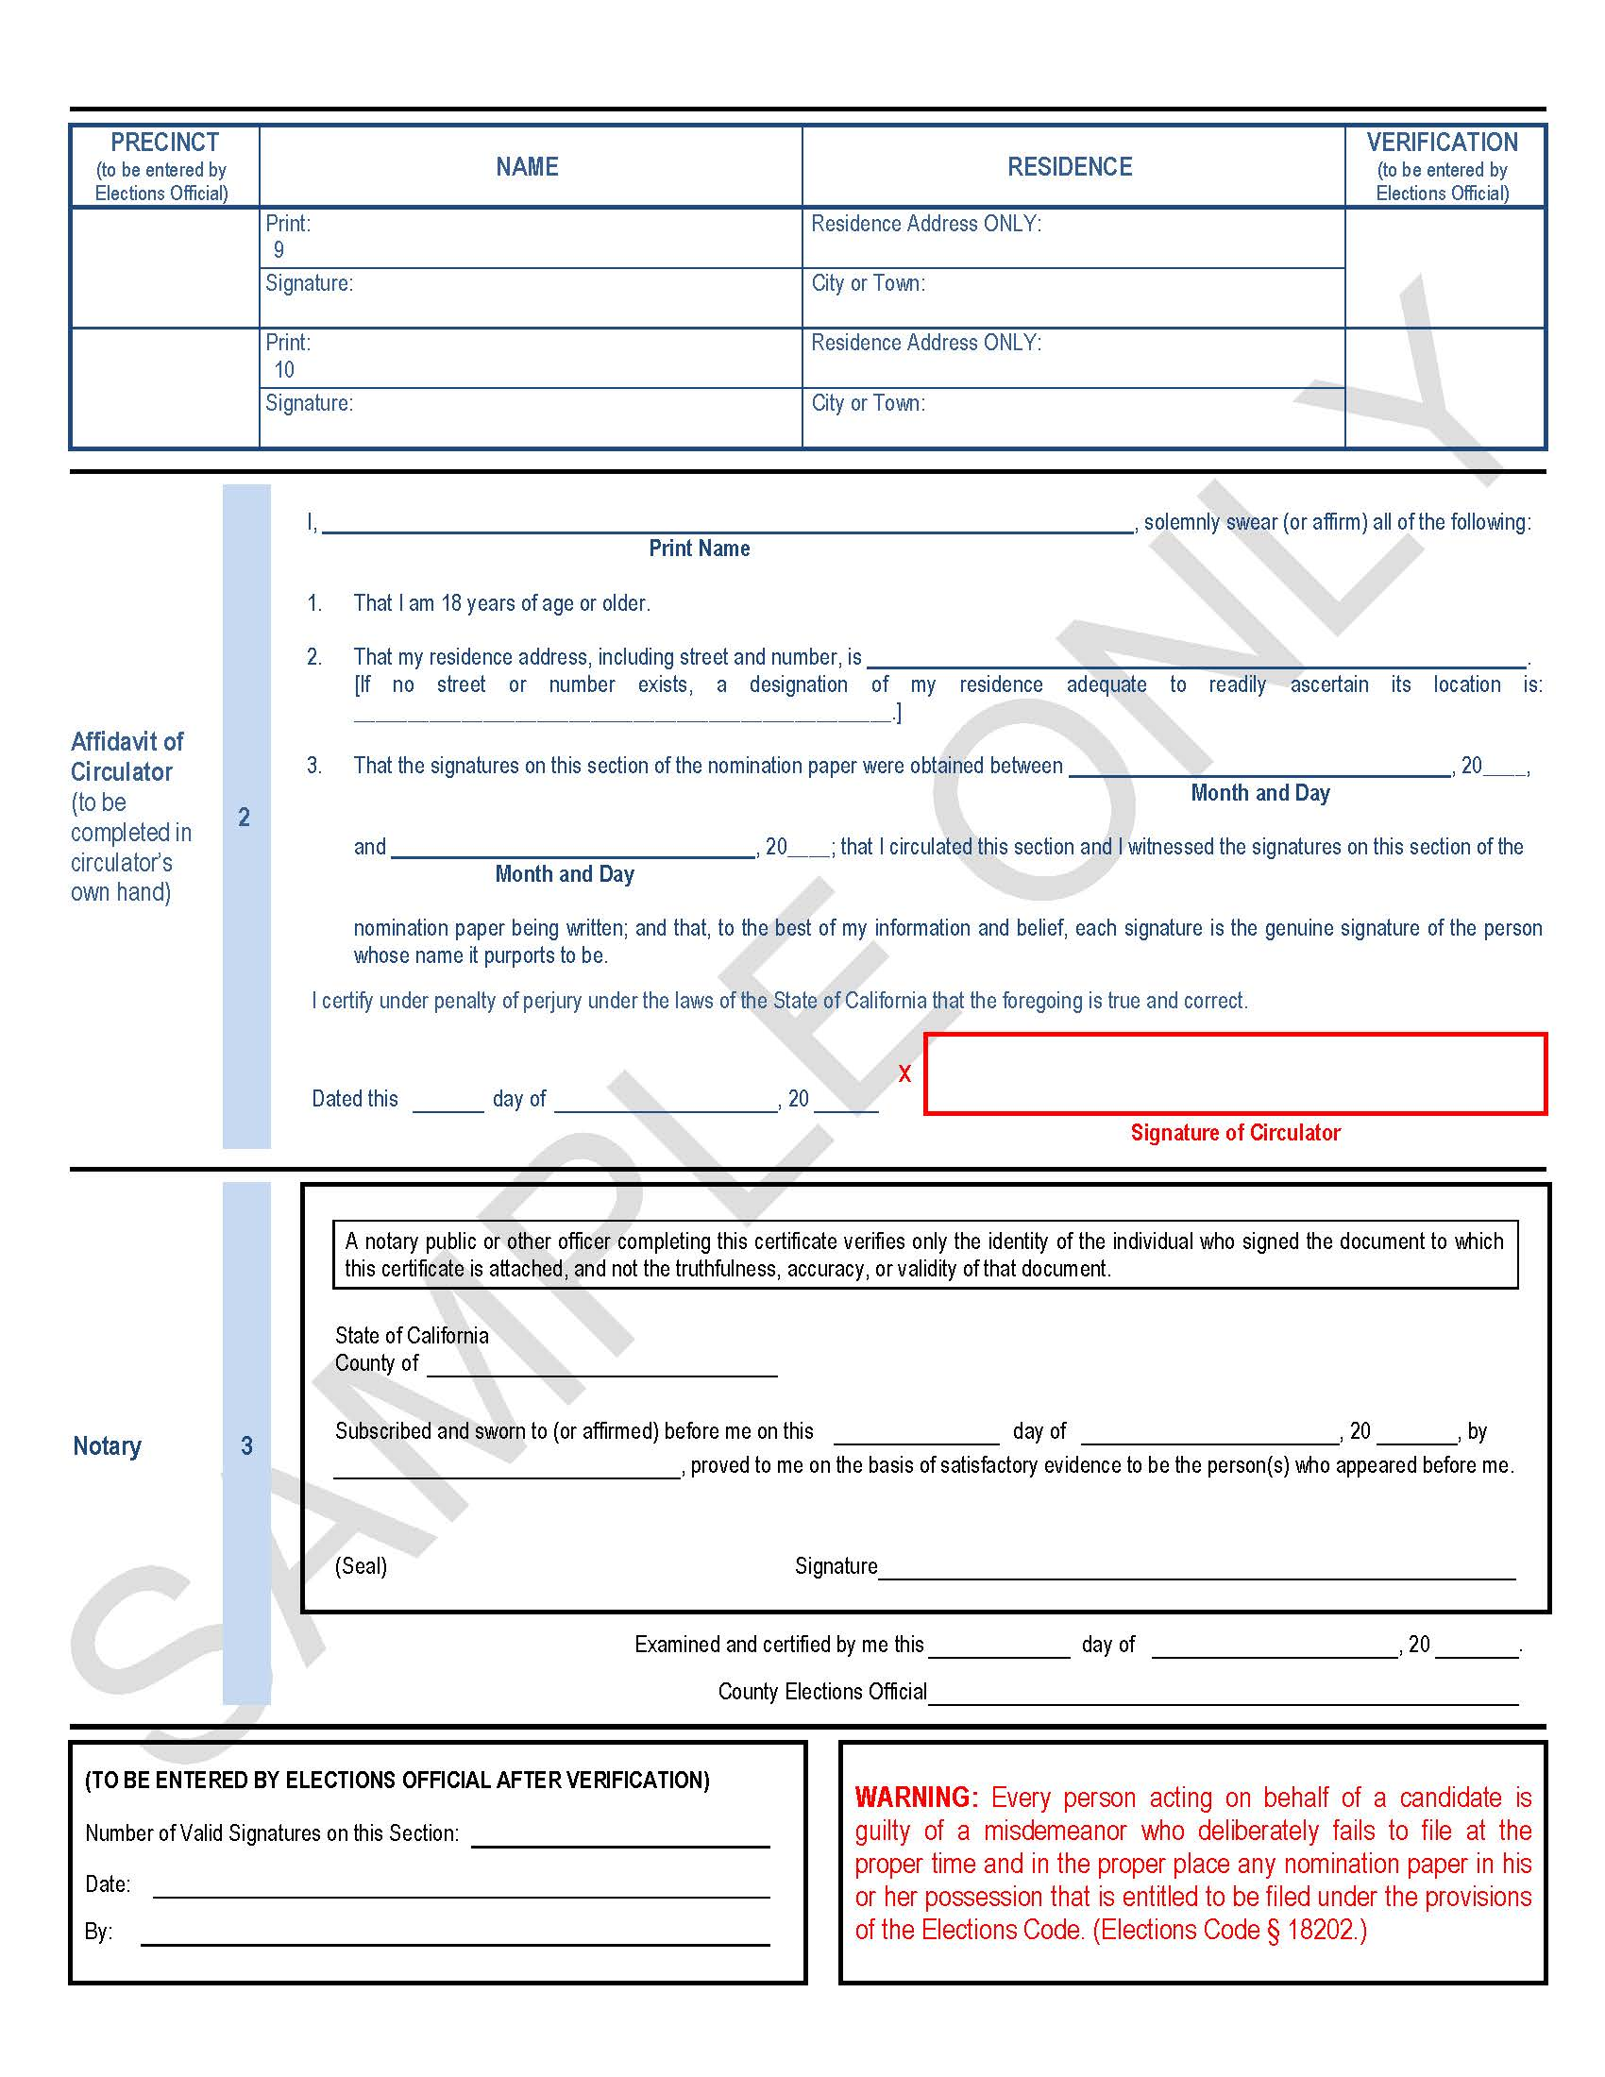
Signature-in-Lieu (SIL) Period: 09.14.23 – 11.08.23 (optional)
Facts About Petition Circulation
Circulator must sign in own hand and include the following information on a declaration attached to the petition:
Printed Name
Residence Address
Dates Between Which Collection of Signatures Were Obtained
Declaration must also include:
That a circulator circulated the petition section and witnessed the appending of signatures
That the circulator believes each signature is genuine of the person whose name it purports to be
Circulator is 18 years of age or older
Circulator shall certify content of the declaration as to its truth and correctness, under penalty of perjury as follows:
By signing the declaration
By stating the date and place of execution on the declaration preceding signature
Notes:
bren’s Slide:
Here is an example of the Petition-in-Lieu form also known as a Signature-in-Lieu or SIL form, and some facts about the petition circulation period.
Keep in mind that a circulator’s residence address is required to be included on a petition declaration so if you are concerned about reducing the amount of public exposure of your residence address then we recommend you DO NOT circulate your own Signature-in-Lieu or Nomination Paper petitions.
Elections Code sections 104(a)(b)&(c) further states that…
Wherever any petition or paper is submitted to the elections official, each section of the petition or paper shall have attached to it a declaration signed by the circulator of the petition or paper, setting forth, in the circulator’s own hand, the following:
The printed name of the circulator.
The residence address of the circulator, giving street and number, or if no street or number exists, adequate designation of residence so that the location may be readily ascertained.
The dates between which all the signatures to the petition or paper were obtained.
Each declaration submitted pursuant to this section shall also set forth the following:
That the circulator circulated that section and witnessed the appended signatures being written.
That according to the best information and belief of the circulator, each signature is the genuine signature of the person whose name it purports to be.
That the circulator is 18 years of age or older.
The circulator shall certify the content of the declaration as to its truth and correctness, under penalty of perjury under the laws of the State of California, with the signature of the circulator’s name. The circulator shall state the date and the place of execution on the declaration immediately preceding the circulator’s signature.

Slide 9
Declaration of Intention Period
October 30, 2023 to November 8, 2023
Notes:
bren’s Slide:
We are now moving onto the Declaration of Intention Period…

Slide 10
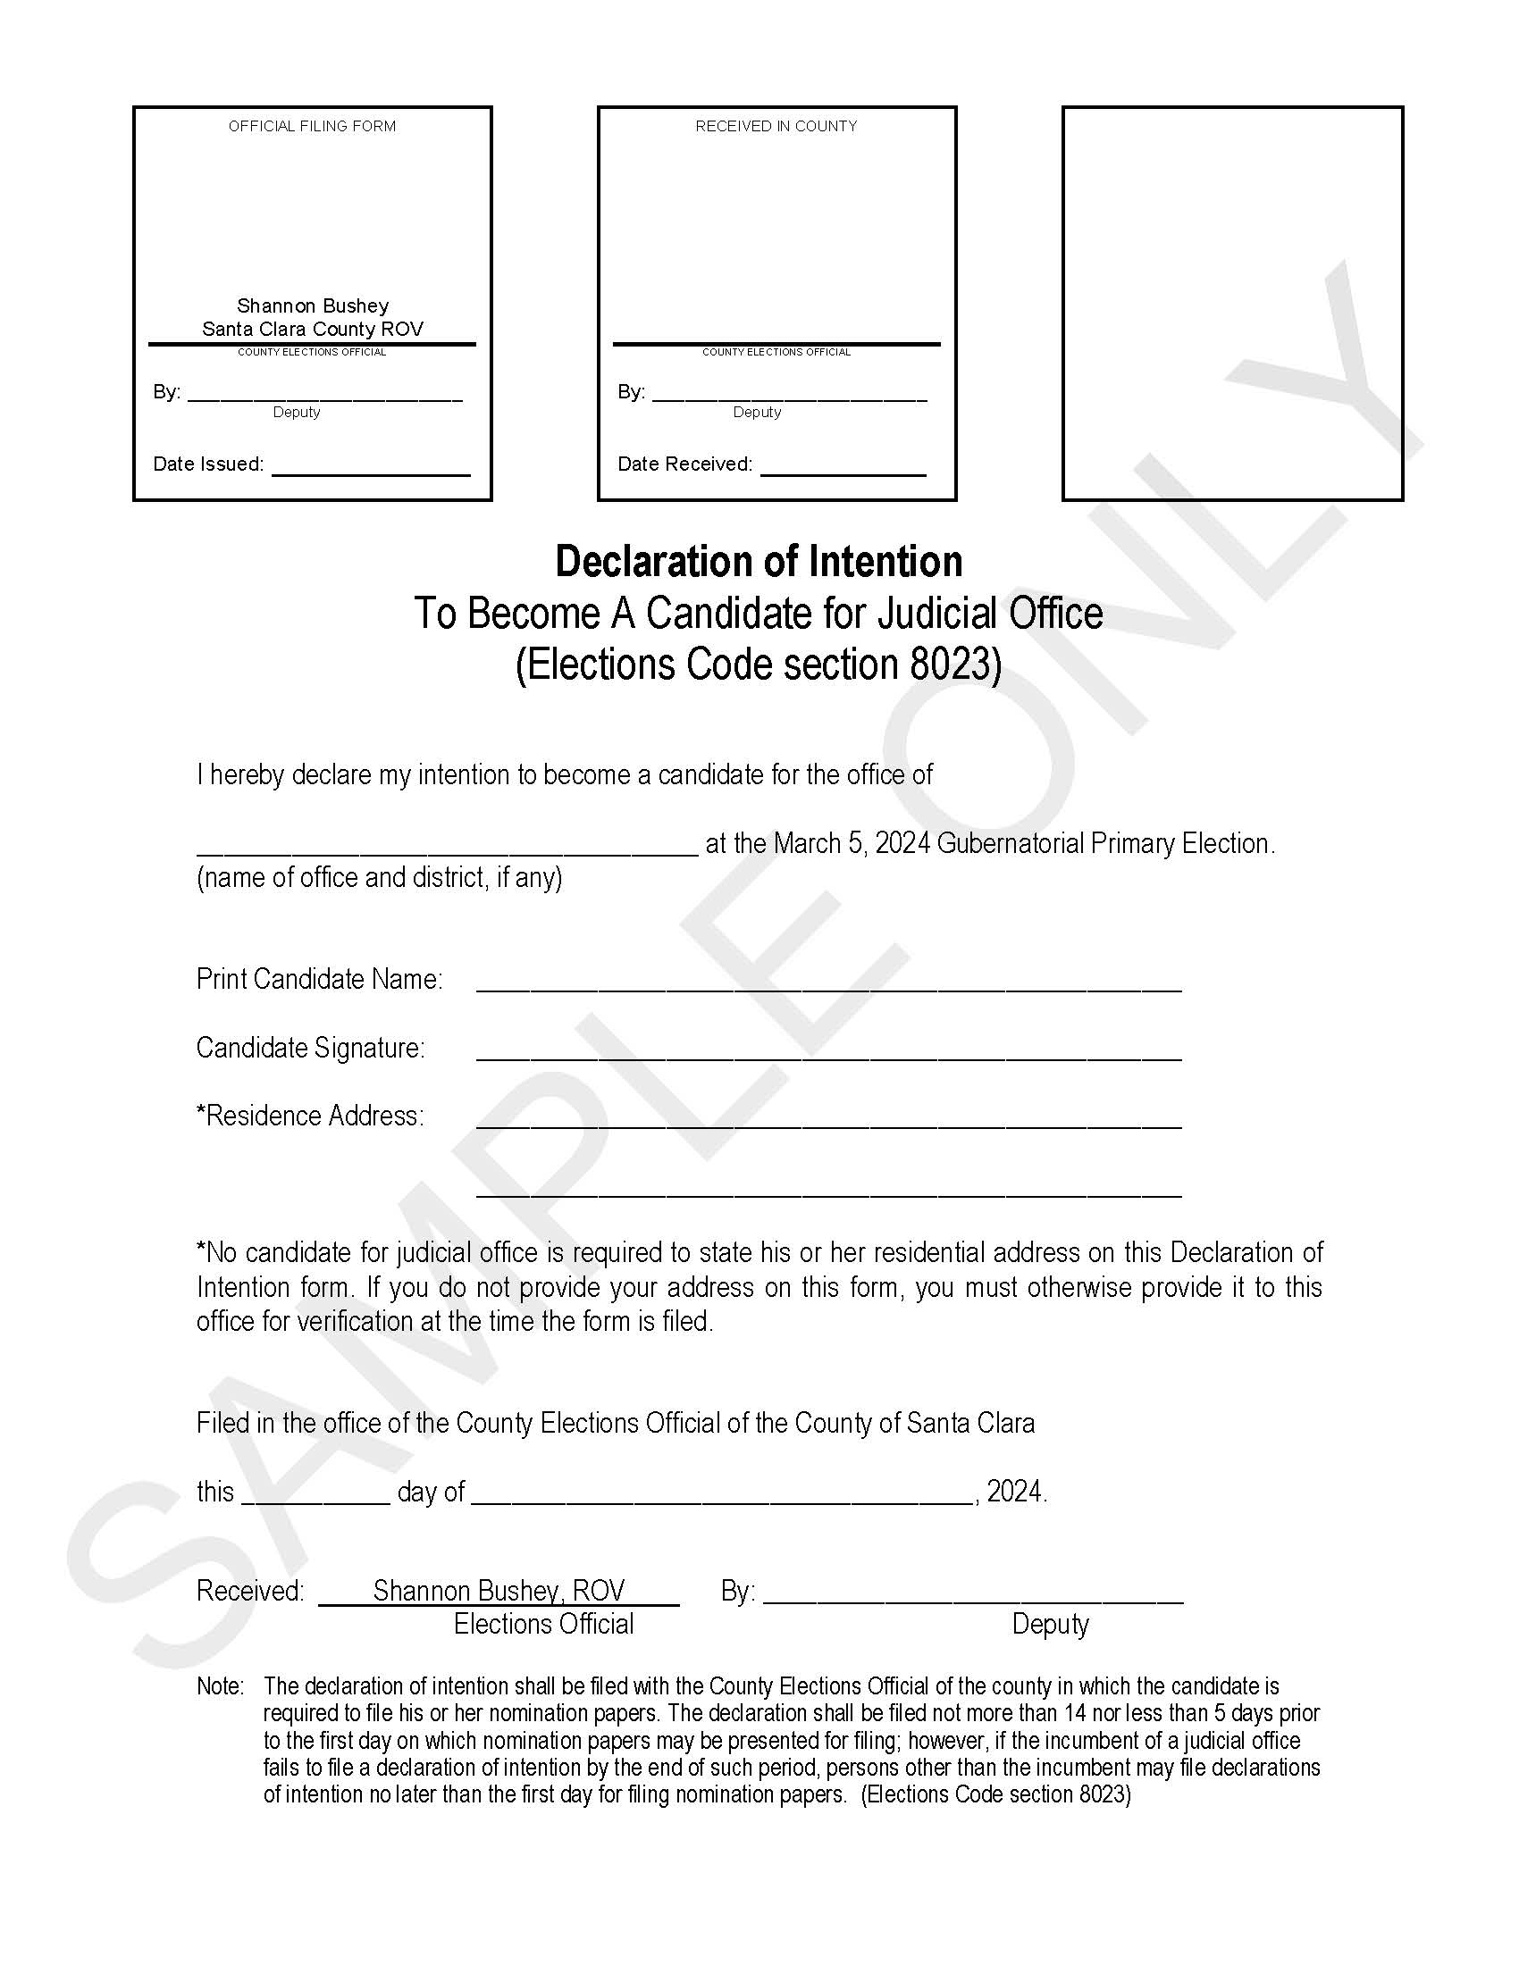
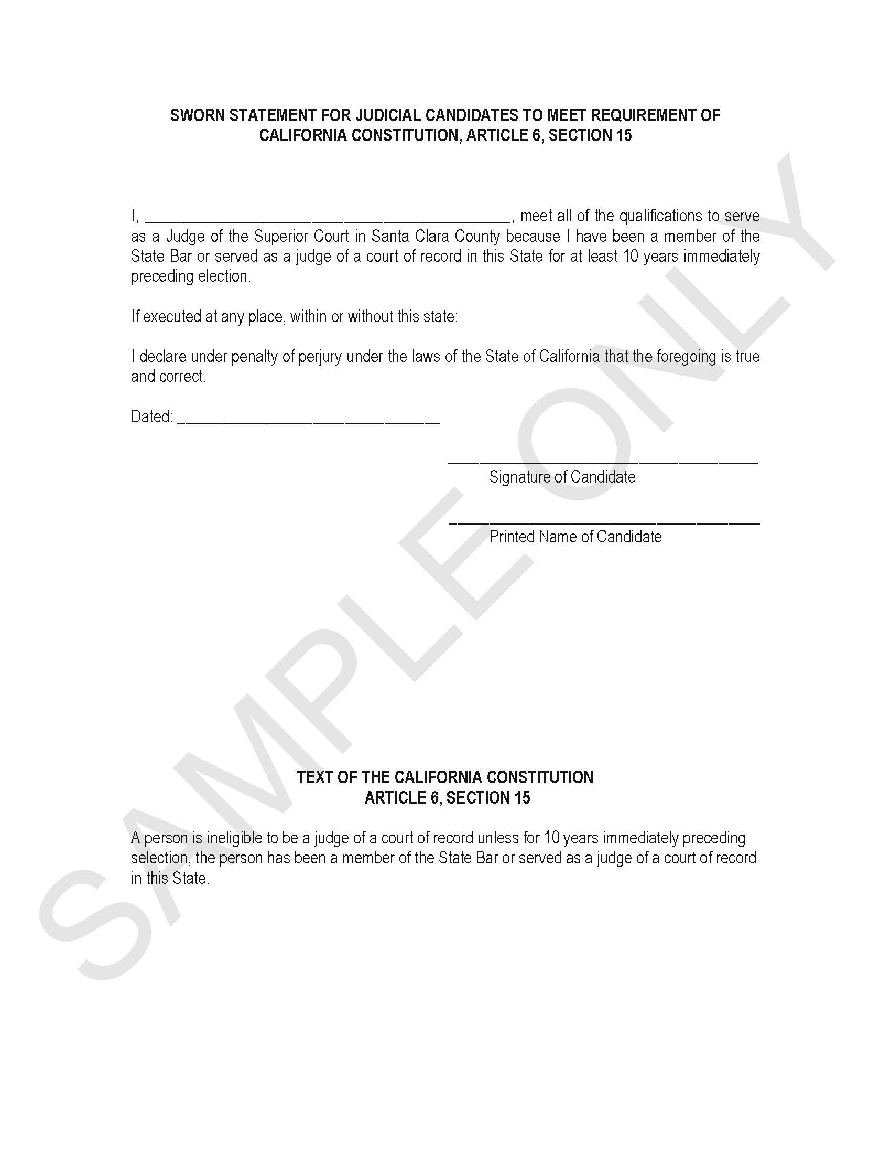
Declaration of Intention (DOI) Period: 10.30.23-11.08.23(required)
Filing Fee of $2,323.99 is due when the Declaration of Intention and Sworn Statement of Qualifications are Filed
Cash, Check, Cashier’s Check, or Money Order Accepted
Sworn Statement of Qualifications
Document Signed Under Penalty of Perjury
10-Year State Bar Membership or Judge of a Court of Record Preceding the Election
Filed with the DOI
Extension Period: Nov 9 – Nov 13, 2023
In the event the incumbent does not file the DOI to succeed to the same office, then any person other than the incumbent (or an authorized agent of the incumbent) can file a DOI no later than the first day of filing nomination papers
Notes:
bren’s Slide:
The filing fee of $2,323.99 is due when the Declaration of Intention (also known as a DOI) is filed. A Sworn Statement of Qualifications (also know as an SSQ) will also be issued and may be filed at the time SILs are pulled or at the time of filing the DOI. The ROV will accept Cash, a Check, Cashier’s Check, or Money Order for your filing fee.
Here is an example of the DOI and the SSQ.
In accordance with Elections Code section 8023(a) both documents must be filed in the ROV’s office not more than 14 days nor less than five days prior to the first day on which a candidate nomination papers may be circulated or signed. This means, you MUST have your DOI and SSQ forms filed with the ROV between October 30, 2023 and November 8, 2023, so that when the beginning of the nomination period opens on November 13, 2023, ROV staff can issue nomination documents to you.
When signed and filed with the ROV’s office the Declaration of Intention will declare a candidate’s intention to become a candidate. This is a required document to be filed during this filing period. As a reminder, this document cannot be accepted along with the other nomination documents that will be filed during the nomination period. Additionally, no candidate for judicial office is required to state his or her residential address on the DOI; however, if you do not provide your address to an Election Specialist on the form, then you must provide it to our office for verification of eligibility at the time the form is filed.
In accordance with elections code section 8023(b), in the event an incumbent does not file their DOI to succeed to the same office by November 8, 2023, then that seat goes into extension between November 9 and November 13, 2023, and any person other than the incumbent (or an authorized agent of the incumbent), can file a DOI no later than the first day of filing nomination papers.
Another reminder, that along with the DOI you will be required to file a Sworn Statement of Qualifications. This document provides that the candidate has met the qualifications of Article 6, Section 15 of the California Constitution that “A person is ineligible to be a judge of a court of record unless for 10 years immediately preceding selection, the person has been a member of the State Bar or served as a judge of a court of record in this State”

Slide 11
This Photo by Unknown Author is licensed under CC BY-SA
Notes:
BREN’S SLIDE:
At this point, I’d like to check if there are any questions? And if none, then I’ll pass it on to Election Specialist Cassandra Hevia who will share information related to the Nomination Period.

Slide 12
Nomination Period
November 13, 2023 to December 8, 2023
Notes:
CASSANDRA’s Slide:
Thank you, Bren…
We are now moving onto the Nomination Period…

Slide 13
Nomination Period
DO NOT forget to file your
Declaration of Intention & Statement of Qualifications Forms
Between October 30 – November 8, 2023 (must be filed five days preceding Nomination Period)
Nomination Period Opens:
November 13, 2023
Nomination Period Ends:
December 8, 2023
All nomination documents, including nomination petitions, must be filed at the same time!
Notes:
CASSANDRA’s Slide:
Friendly reminder to please file your Declaration of Intention and Sworn Statement of Qualifications between October 30 – November 8, 2023. These documents must be filed five days preceding the nomination period.
As you can see on this page the nomination period begins at 8:00 a.m. on Monday, November 13, 2023, and ends at 5:00 p.m. on Friday, December 8, 2023.
Please remember, when you are ready to file your nomination documents, you’ll be required to file all nomination documents at the same time. We’ll go over all required and optional nomination documents to be filed over the next few slides.

Slide 14
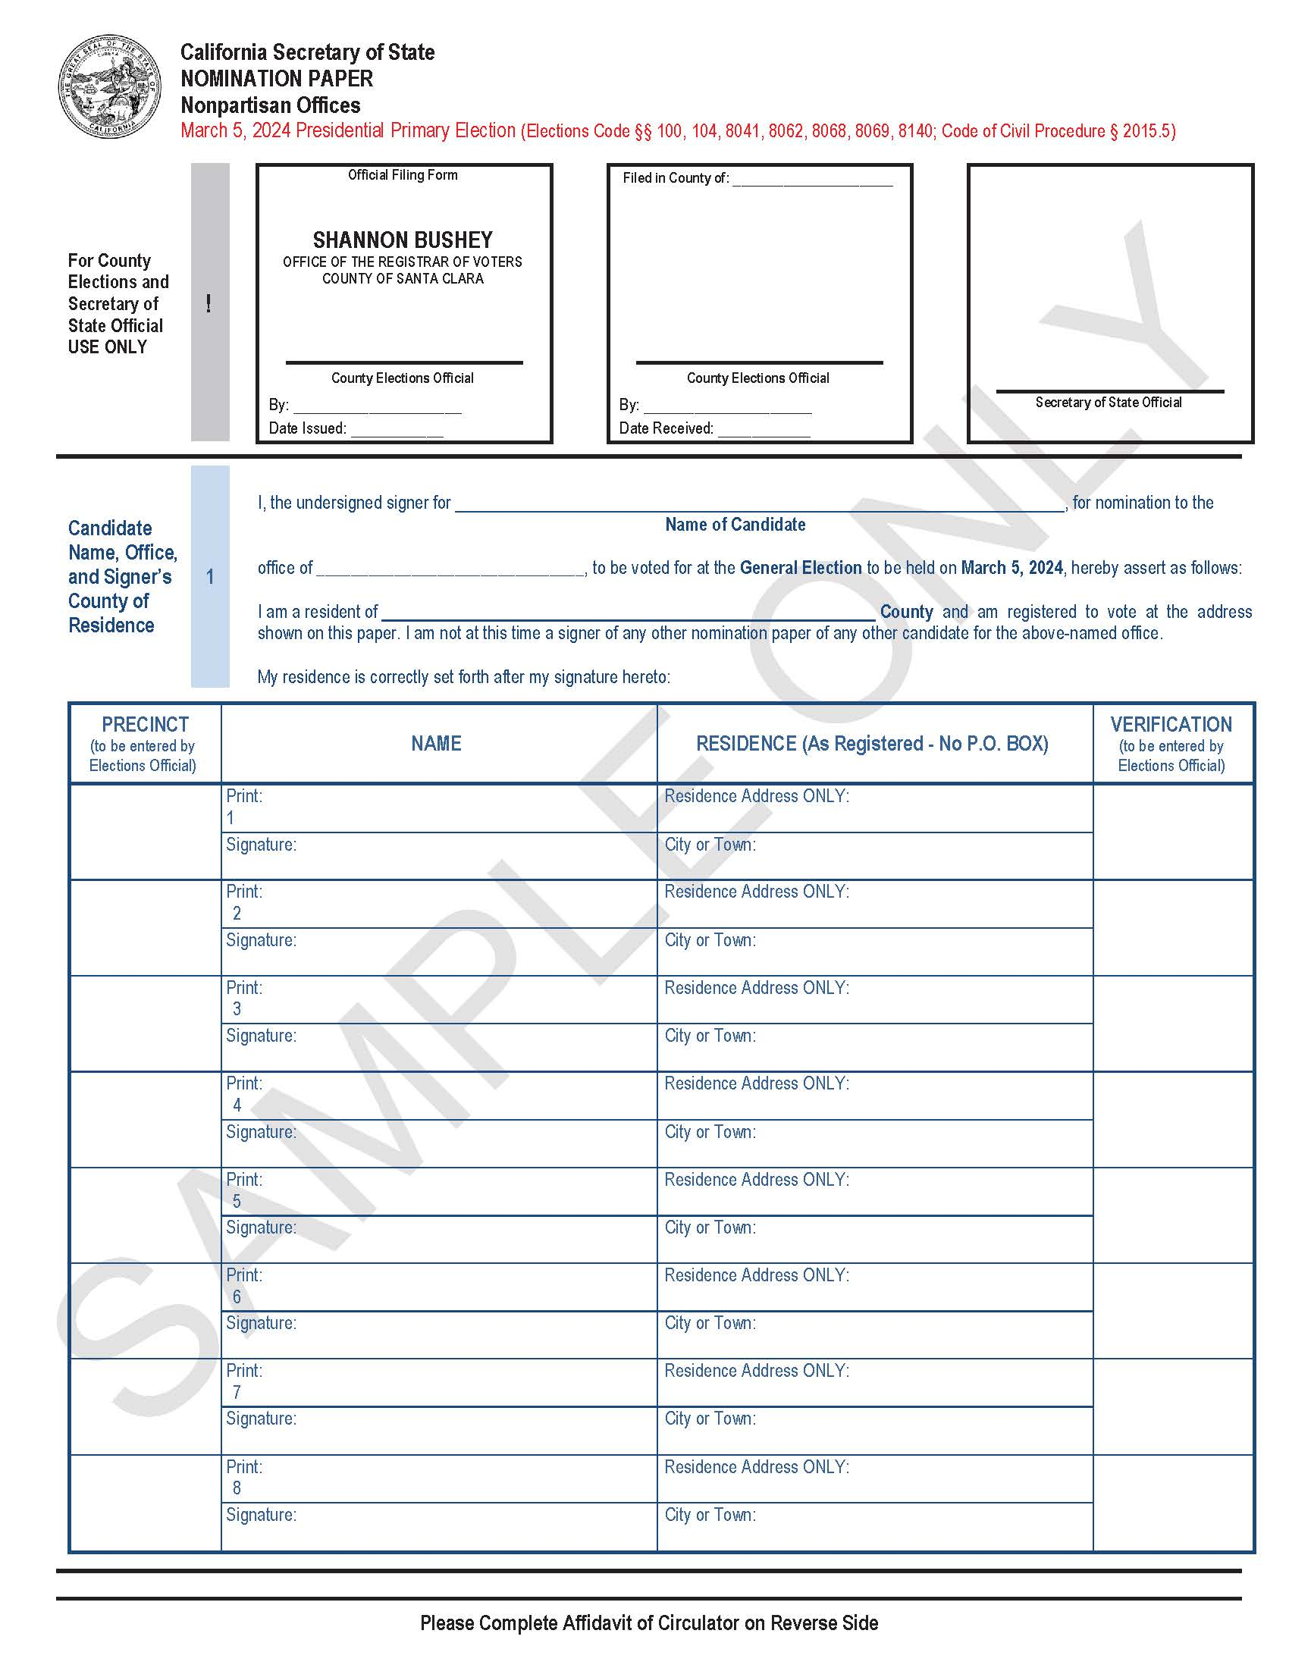
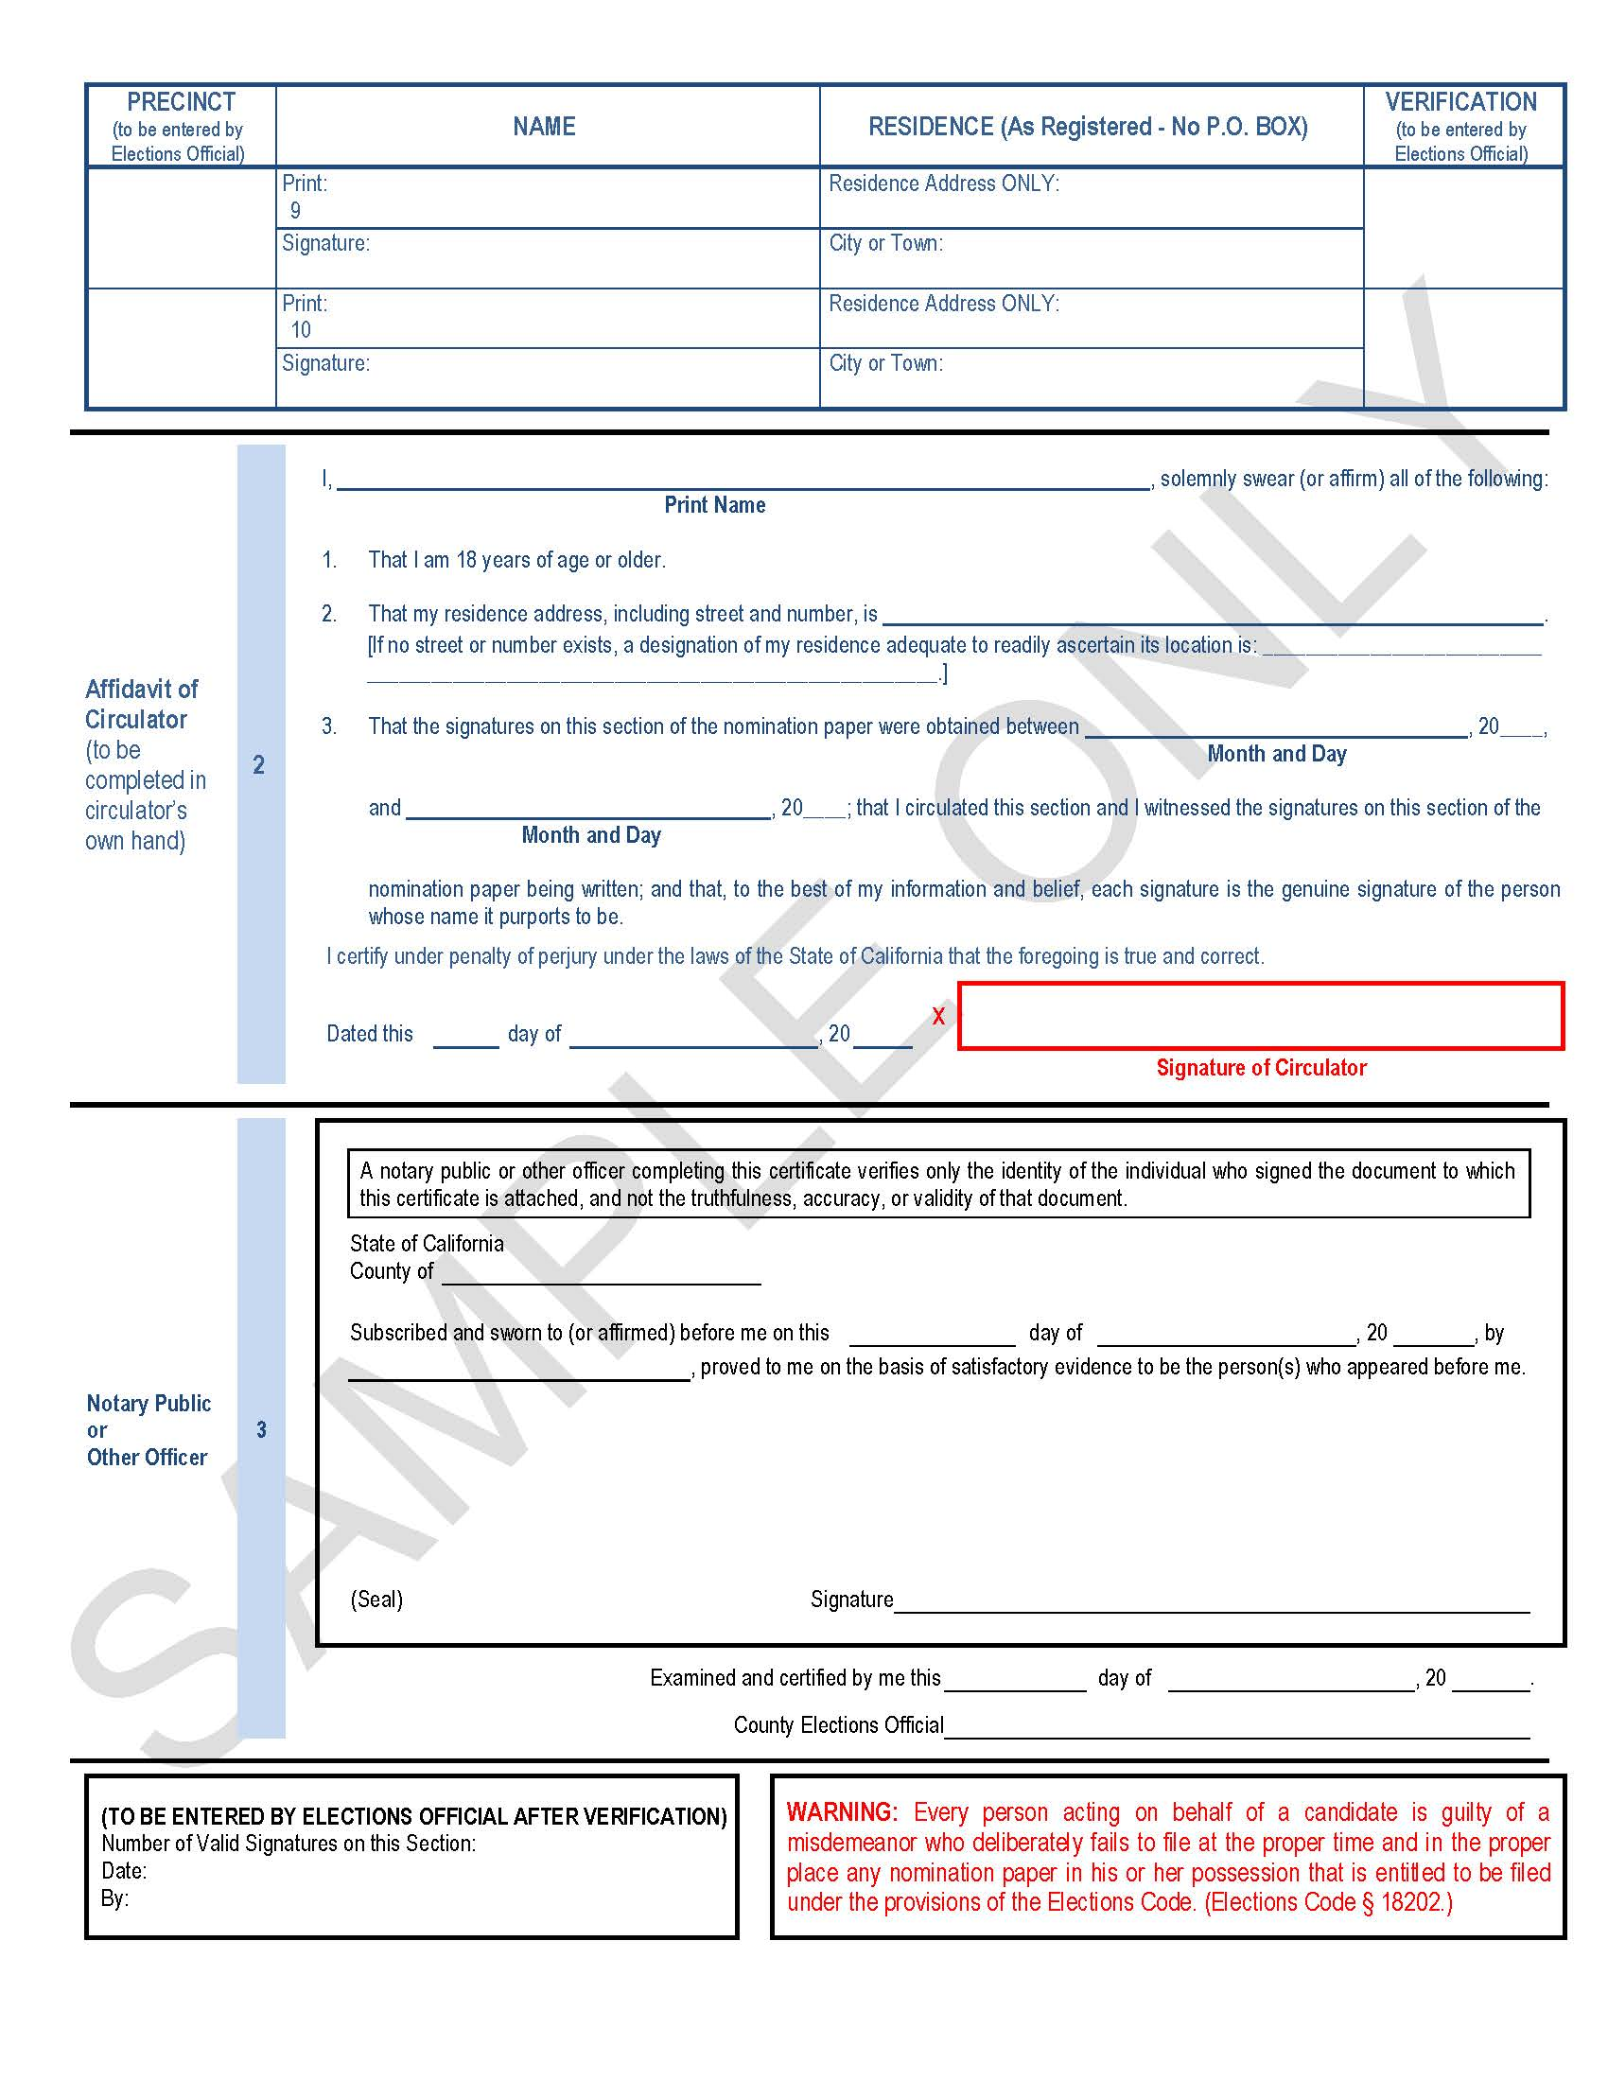
Nomination Paper (required)
20 valid nomination signatures are required and must be submitted at one time; no more than 40 signatures may be submitted.
A judge who runs unopposed shall not appear on the ballot unless forced by petition to allow for a write-in candidate at the next general election.
Terms are six years beginning the Monday after January 1 following the election January 6, 2025
Notes:
CASSANDRA’s Slide:
During the Nomination Period, a nomination paper is required and must be filed at the same time as all other nomination documents.
Here is an example of the Nomination Paper. It looks very similar to a Petition-in-Lieu paper so please be sure to use the correct form during the intended period.
Keep in mind that if a candidate has collected at least 20 signatures of valid registered voters during the SIL period, then no additional signatures are required during the nomination period, and a nomination paper will not be issued by an Election Specialist, nor filed during the Nomination Period.
Otherwise, you may collect up to 40 signatures during the Nomination Period and submit to the ROV’s office for verification at the same time you file your other nomination documents. All signatures must be from valid registered voters in the County of Santa Clara, and again, you must obtain 20 signatures to qualify to be a candidate.
Article 6, Section 16 (b) - Judges of superior courts shall be elected in their counties at general elections except as otherwise necessary to meet the requirements of federal law. Any judicial seat wherein the judge was previously an unopposed incumbent, his or her name may not appear on the ballot unless forced by petition to allow for a write-in campaign. I’ll discuss this in more detail later in the presentation.
However, if the incumbent and one or more eligible candidates file nomination documents, the judicial seat will be on-ballot and include a write-in campaign.
Article 6, Section 16 (c) Terms of judges of superior courts are six years beginning the Monday after January 1 following their election. Thus, your term will begin on January 6, 2025. If a vacancy occurs during the six-year term period, the vacancy shall be filled by election to a full-term at the next general election after the second January 1 following the vacancy, but the Governor shall appoint a person to fill the vacancy temporarily until the next regular election.

Slide 15
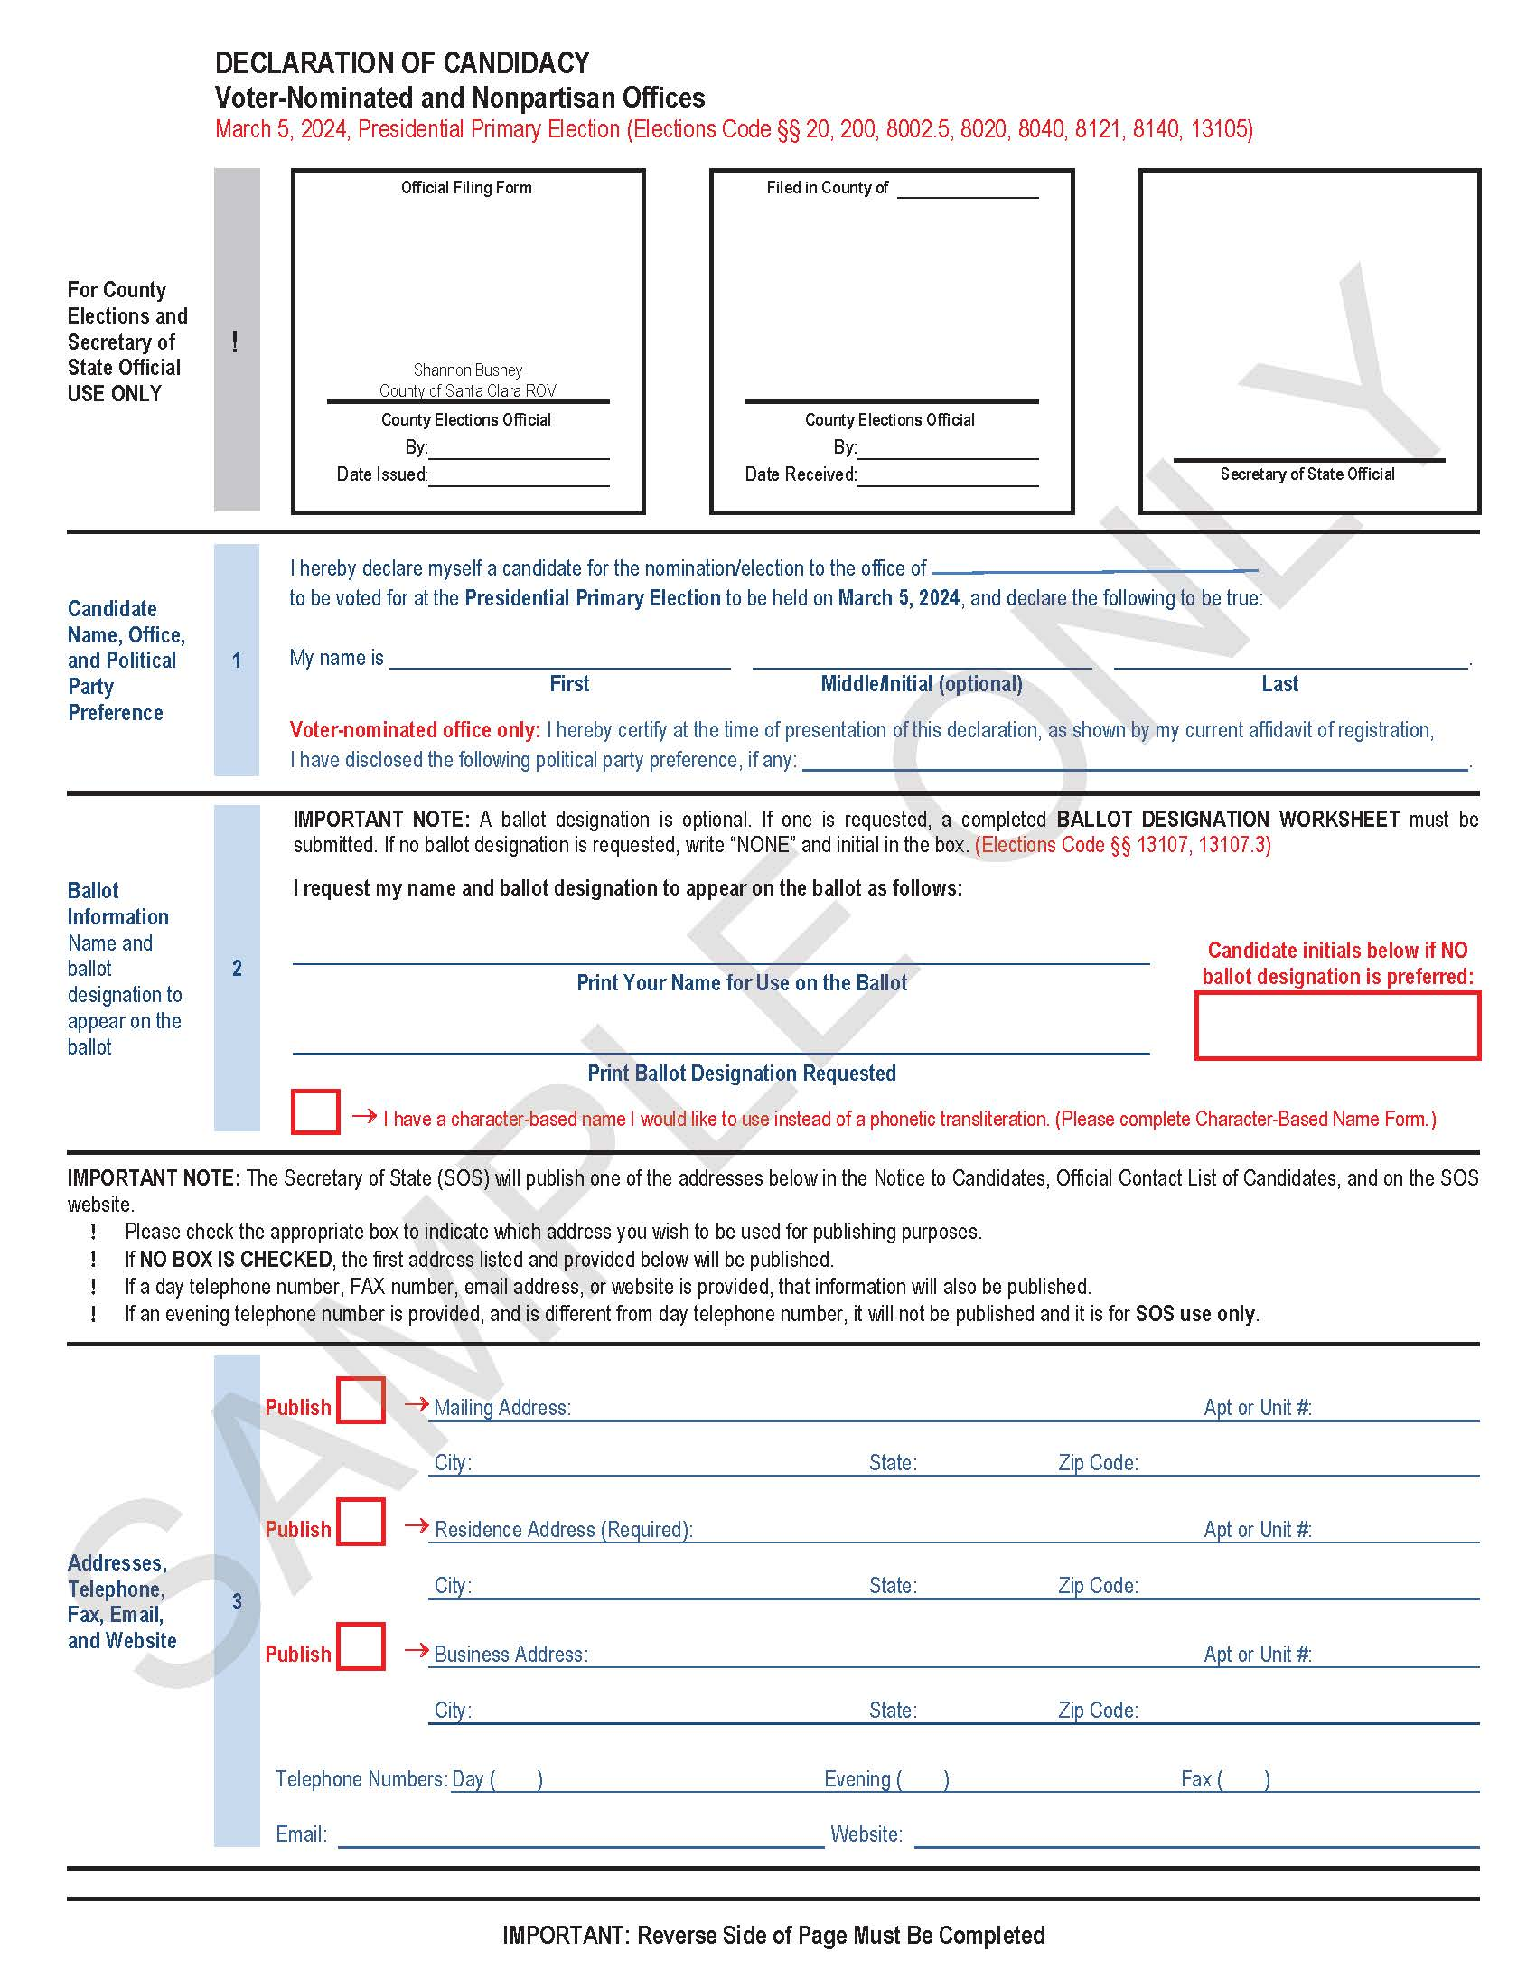
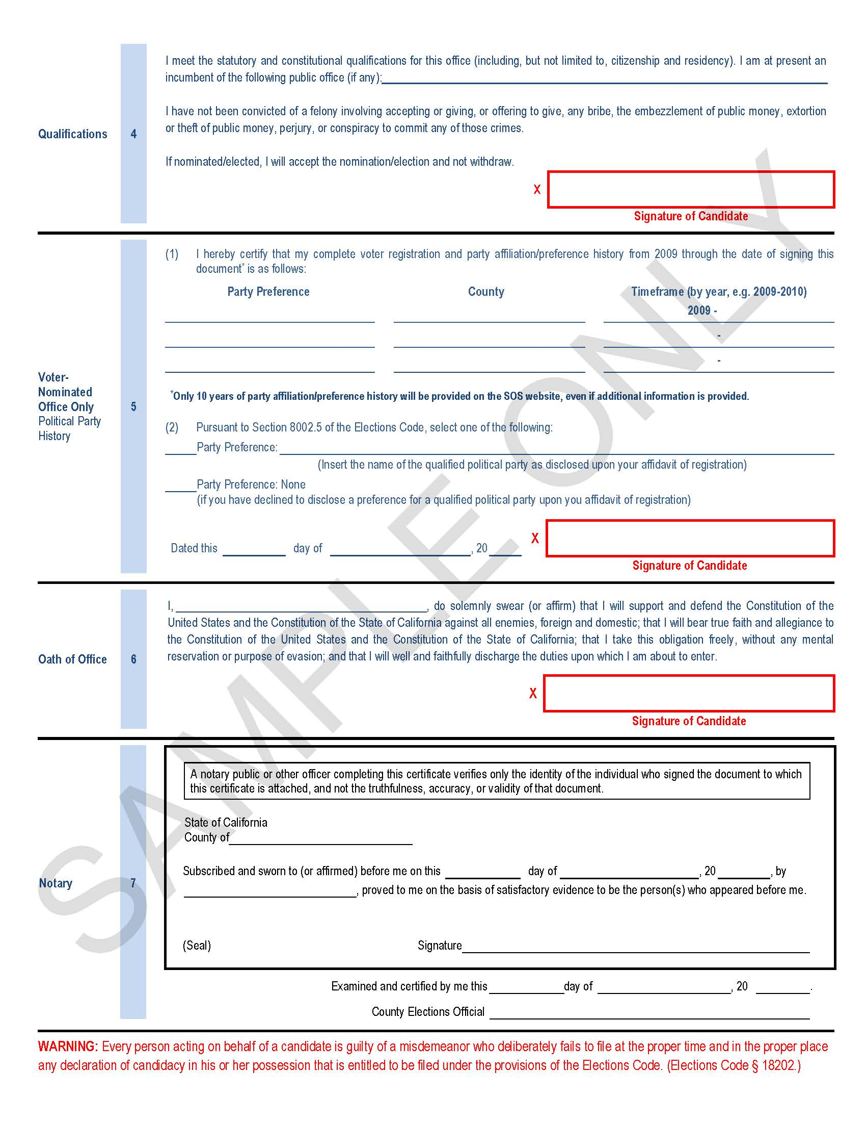
Declaration of Candidacy (required)
Required to be filed with other Nomination Documents
Cannot be Removed from the office of the ROV
Written Statement Signed & Dated by Candidate to Designate Authorized Agent
Form Includes Office Sought and Name of Candidate and Ballot Designation
Character-Based Name
Publication of Contact Information
Qualifications and Oath of Office
Notes:
CASSANDRA’s Slide:
During the nomination period, a Declaration of Candidacy form (not to be confused with the Declaration of Intention form); otherwise, known as a DOC, is required to be filed with all other nomination documents. In accordance with Elections Code section 8028(a) a candidate shall not remove a declaration of candidacy form from the office of the elections official, and the elections official shall require all candidates filing a DOC to execute the declaration in the office of the ROV.
Additionally, Elections Code section 8028(b) states that a candidate may, in a written statement signed and dated by the candidate, designate a person to receive the DOC form from the ROV’s office, and deliver it to the candidate. If a candidate requires this form, please be sure to inquire with an Election Specialist. Our form, in addition to the Declaration of Candidacy, allows for all other nomination documents to be issued and filed by an authorized agent of the candidate. The form also indicates that the candidate is aware that all documents including the declaration of candidacy must be properly executed and delivered to the ROV’s office by the 88th day prior to the direct primary election which is no later than December 8, 2023, end of the Nomination Period.
On the first page of the DOC, the candidate will include the name of the office sought along with his or her printed first, middle or last name. Please be sure to include any hyphenated last names only on the “Last Name” line. Please also print the approved ballot designation exactly as it appears on the ballot designation worksheet.
Moreover, if you have a character-based name please check the red box and fill out the Preferred Transliteration form issued by the ROV.
Please also fill out the section that includes addresses, telephone, fax, email, and/or website information. Keep in mind that the ROV will publish one of the addresses listed on your DOC on the ROVs website. Please be sure to check each appropriate box to indicate which address you wish to be used for publication purposes. If no box is checked, the first address listed and provided, will be published. If a day telephone number, fax number, email address or website is provided, that information will also be published. If an evening telephone number is provided, and is different from the day telephone number, it will not be published and will only be used for ROV use.
An alternative option is also available to indicate that you do not want any information published.
You will also be asked to fill out your qualifications in Section 4 on page 2 and take an Oath of Office. If you, do not take your oath of office at the ROV’s office, then you must have the document notarized as to the validity of your identity.

Slide 16
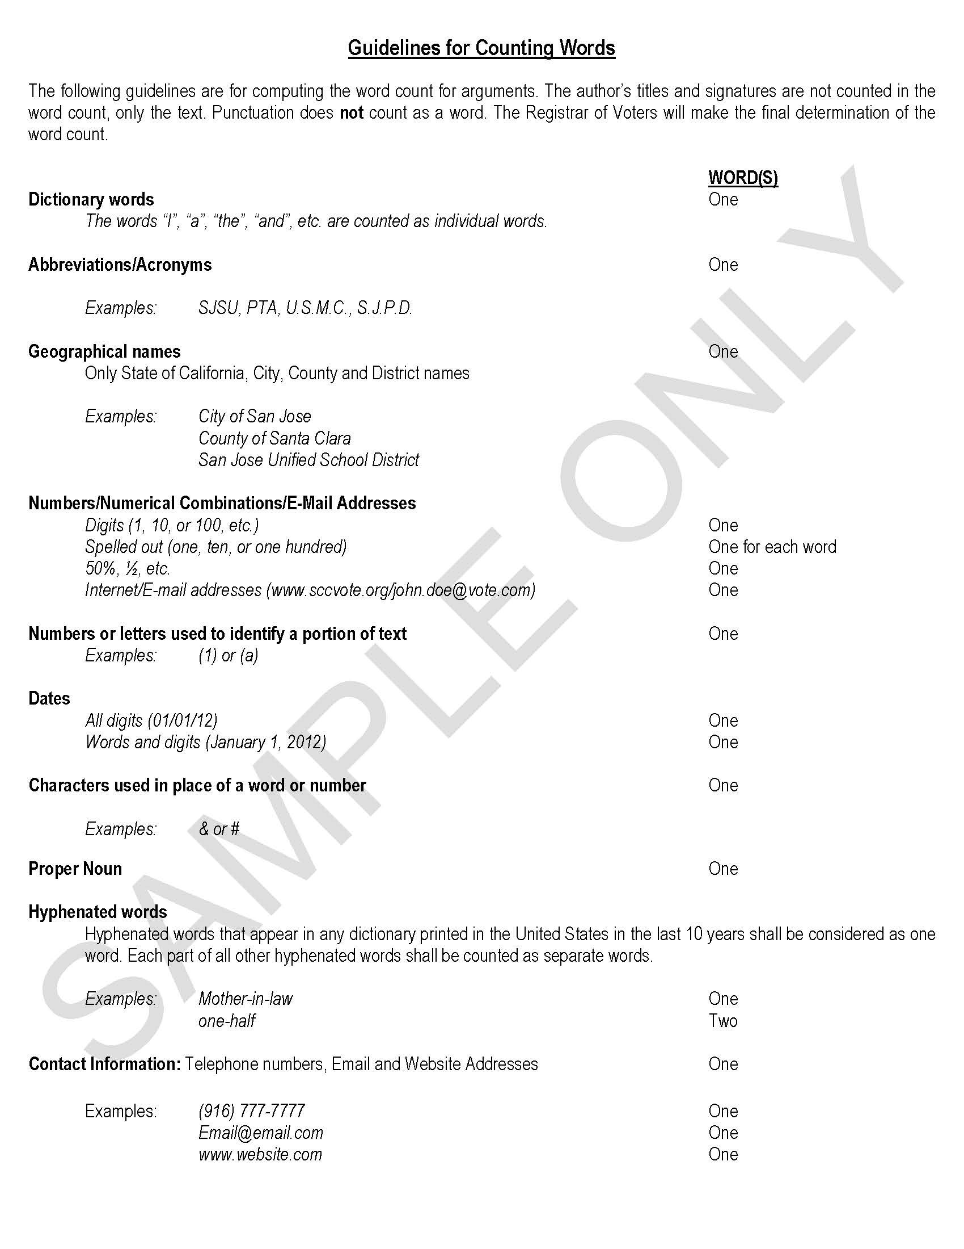
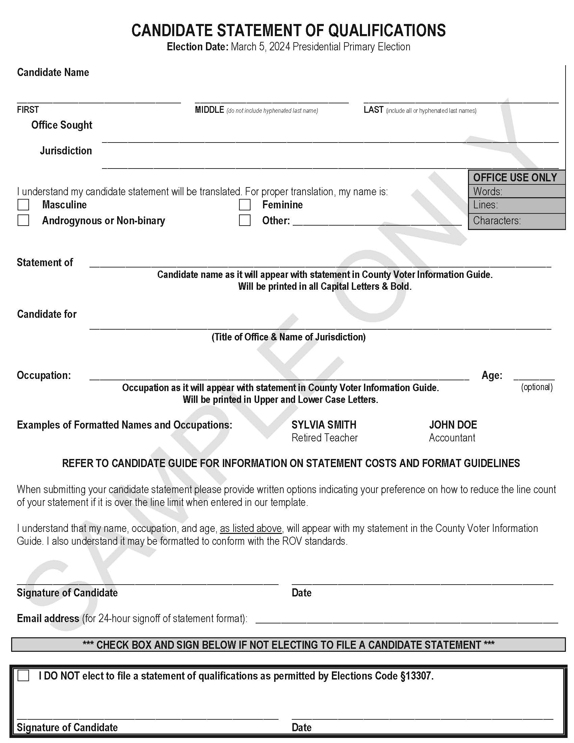
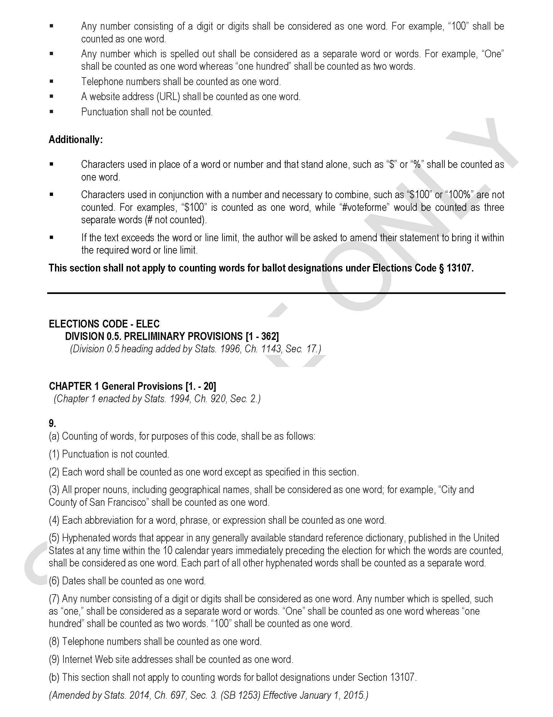
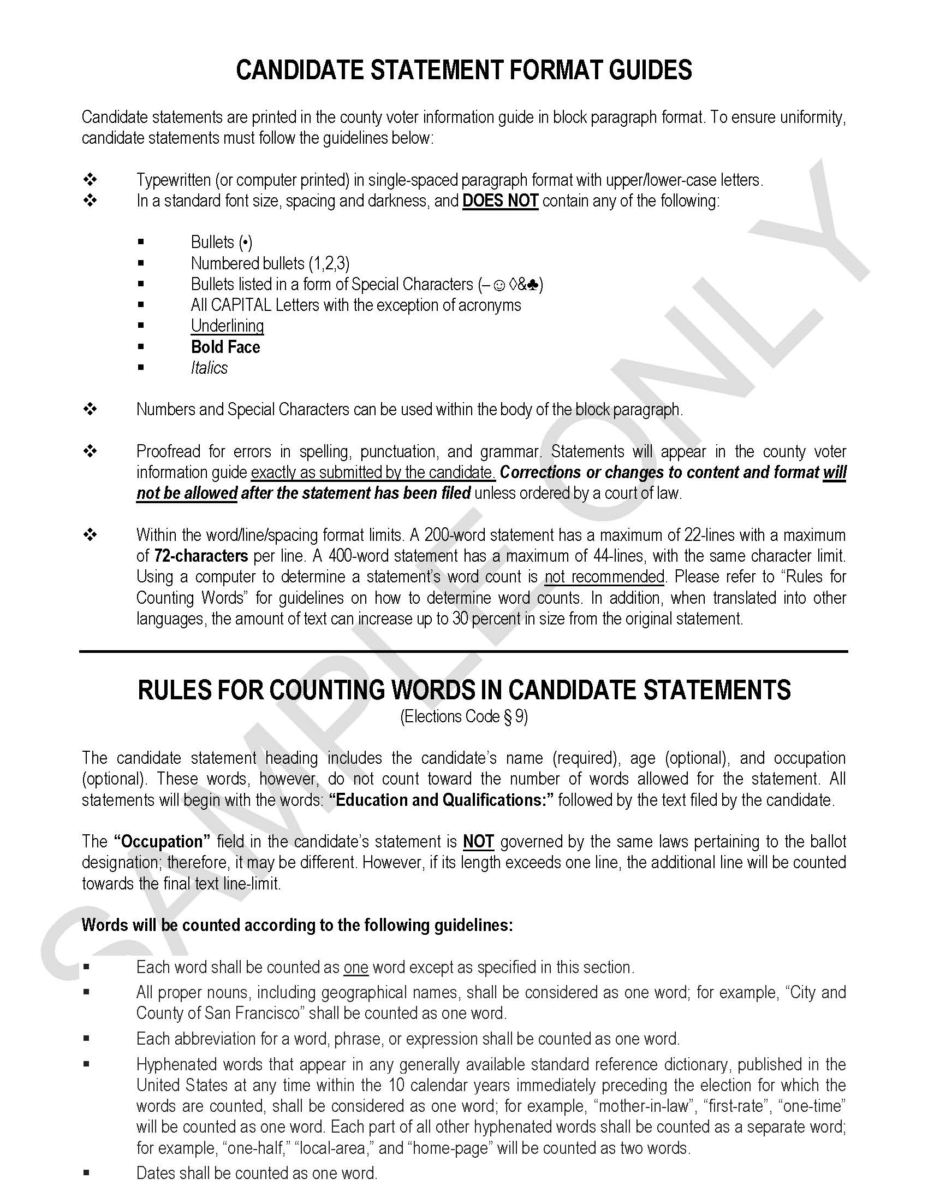
Candidate Statement of Qualifications
A Candidate Statement may be Purchased for Inclusion in the County Voter Information Guide (CVIG) Estimated Candidate Statement Deposit: $2,320 Payment is due when a candidate statement is filed. Candidate statement deposits will be refunded if the contest is not included on the ballot.
Notes:
CASSANDRA’s Slide:
A Candidate Statement may be Purchased for Inclusion in the County Voter Information Guide (CVIG) Here is an example of the candidate statement of qualifications form. The candidate will include his or her name and office sought, as well as how he or she would like their name transliterated. Additionally, the candidate may use the second page to add a statement or attach a separate document to the form.
Keep in mind that Format Guides are also included with the form and require your attention to ensure you use the proper format when writing your statement. Here is an example of those format guides along with references to respective election code sections.
The estimated Candidate Statement Deposit is: $2,320.00 Payment is due when a candidate statement is filed. The ROV accepts forms of payment in cash, check, cashier's check, and money order.
Please keep in mind that the Candidate Statement Deposit is an estimate only. Our Fiscal Division will evaluate election costs later after the nomination period; therefore, the candidate may receive a refund or be required to pay an amount over the amount of the deposit. You’ll be notified of any refund or requirement to pay additional funds toward your statement about 1-2 months following the certification of the March 5, 2024 Presidential Primary Election.

Slide 17
This Photo by Unknown Author is licensed under CC BY-SA
Notes:
CASSANDRA’S SLIDE:
At this point, I’d like to check if there are any questions? If none, then I’ll pass it on to Elections Division Coordinator Bren Lehr who will share information related to ballot designations.

Slide 18
Ballot Designation Worksheet
Elections Code Section 13107
(b)(1) Except as specified in paragraph (2), for candidates for judicial office . . . only one of the following designations may appear at the option of the candidate:
(A) Words designating the city, county, district, state, or federal office held by the candidate at the time of filing the nomination documents.
(B) The word “incumbent” if the candidate is a candidate [is the incumbent].
(C) No more than three words designating either the current principal professions, vocations, or occupations of the candidate, or the principal professions, vocations, or occupations of the candidate during the calendar year immediately preceding the filing of nomination documents.
(2) For a candidate for judicial office who is an active member of the State Bar employed by a city, county, district, state, or by the United States, the designation shall appear as one of the following:
(A) Words designating the actual job title, as defined by statute, charter, or other governing instrument.
(B) One of the following ballot designations: “Attorney,” “Attorney at Law,” “Lawyer,” or “Counselor at Law.” The designations “Attorney” and “Lawyer” may be used in combination with one other current principal profession, vocation, or occupation of the candidate, or the principal profession, vocation, or occupation of the candidate during the calendar year immediately preceding the filing of nomination documents.
Notes:
bren’s Slide:
Thank you, Cassandra…
A ballot designation will allow a candidate to share with the voter’s, information about themselves. Guidelines for filling out the worksheet include:
Words designating the city, county, district, state, or federal office or job title held by the candidate at the time of filing the nomination documents.
The most common ballot designations used by seated judges are:
Judge of the Superior Court
Superior Court Judge
The word “Incumbent” if the candidate is a candidate for the same office held at the time of filing the nomination papers.
No more than three words designating either the current principal profession, vocation or occupation or the principal profession, vocation or occupation during the calendar year immediately preceding the filing of nomination documents.

Slide 19
Ballot Designation Worksheet (continued)
Elections Code 13107 (cont.)
(b)(3) A designation made pursuant to subparagraph (A) of paragraph (1) or paragraph (2) shall also contain relevant qualifiers, as follows:
(A) If the candidate is an official or employee of a city, the name of the city shall appear preceded by the words “City of.”
(B) If the candidate is an official or employee of a county, the name of the county shall appear preceded by the words “County of.”
(C) If the candidate is an official or employee of a city and county, the name of the city and county shall appear preceded by the
words “City and County.”
(D) If the candidate performs quasi-judicial functions for a governmental agency, the full name of the agency shall be included.
(c) A candidate for superior court judge who is an active member of the State Bar and practices law as one of his or her principal professions shall use one of the following ballot designations as his or her ballot designation: “Attorney,” “Attorney at Law,” “Lawyer,” or “Counselor at Law.” The designations “Attorney” and “Lawyer” may be used in combination with one other current principal profession, vocation, or occupation of the candidate, or the principal profession, vocation, or occupation of the candidate during the calendar year immediately preceding the filing of nomination documents.
Notes:
bren’s Slide:
Additionally,
A ballot designation made pursuant to subparagraph (A) of paragraph (1) or paragraph (2) of Elections Code section 13107 shall also contain relevant qualifiers:
If the candidate is an official or employee of a city, the name of the city shall appear preceded by the words “City of.”
If the candidate is an official or employee of a county, the name of the county shall appear preceded by the words “County of.”
If the candidate is an official or employee of a city and county, the name of the city and county shall appear preceded by the words “City and County.”
If the candidate performs quasi-judicial functions for a governmental agency, the full name of the agency shall be included.
Example: “County of Santa Clara District Attorney”
Candidates may combine words with current principal profession, vocation or occupation:
Example: Lawyer Accountant Father
Candidates for judicial office who are active members of the State Bar and employed by a city, county, district, state, or by the United States can use ballot designations that include words designating the office or actual job title held by the candidate at the time of filing nomination papers.
Example: “Attorney,” “Attorney at Law,” “Lawyer” or “Counselor at Law”

Slide 20
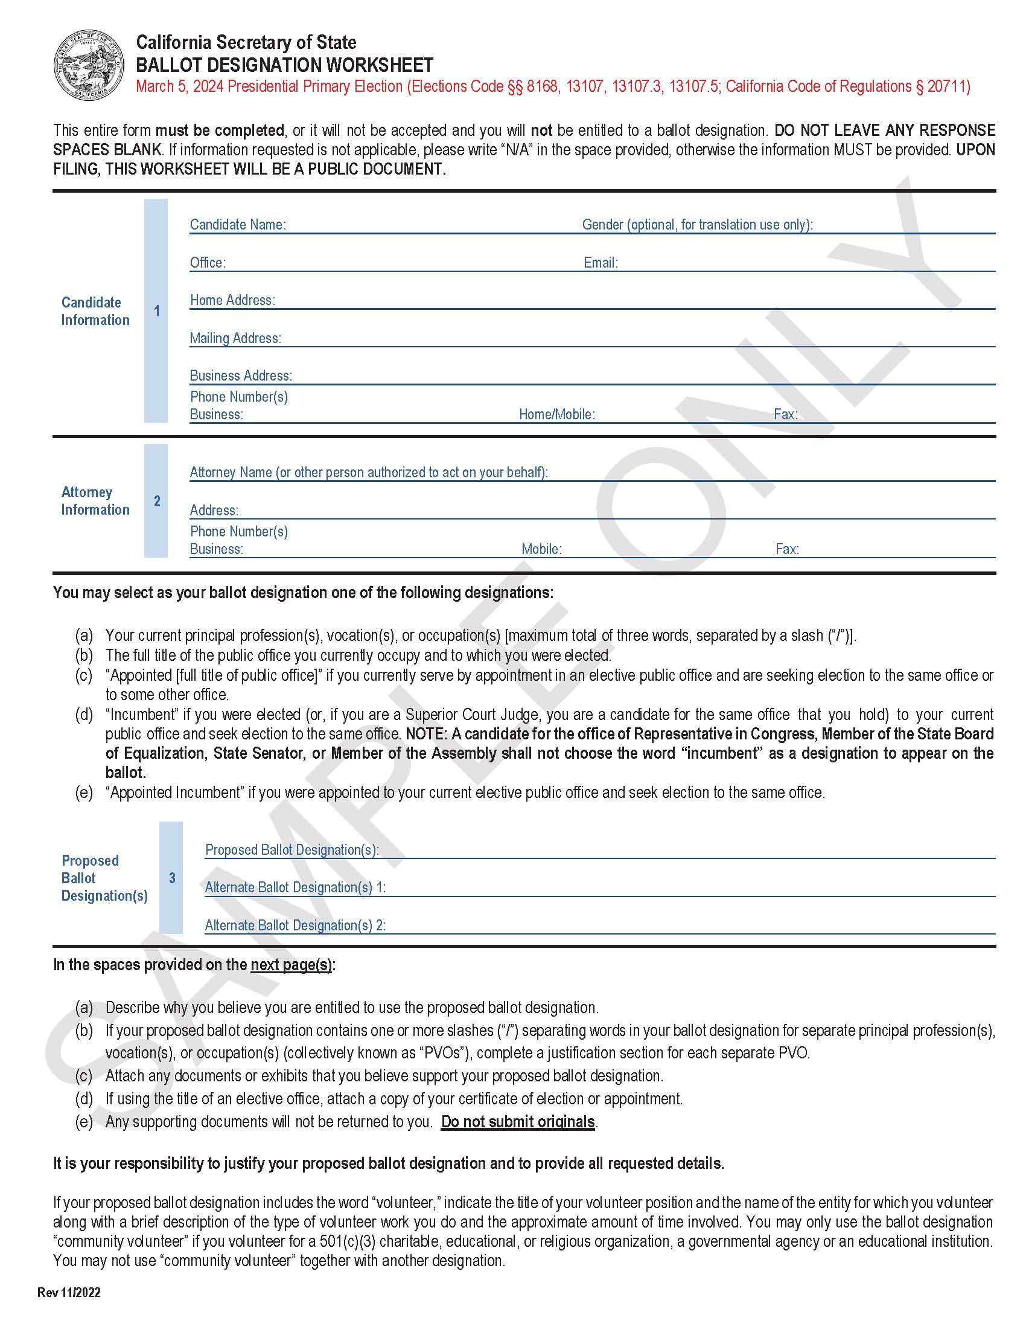
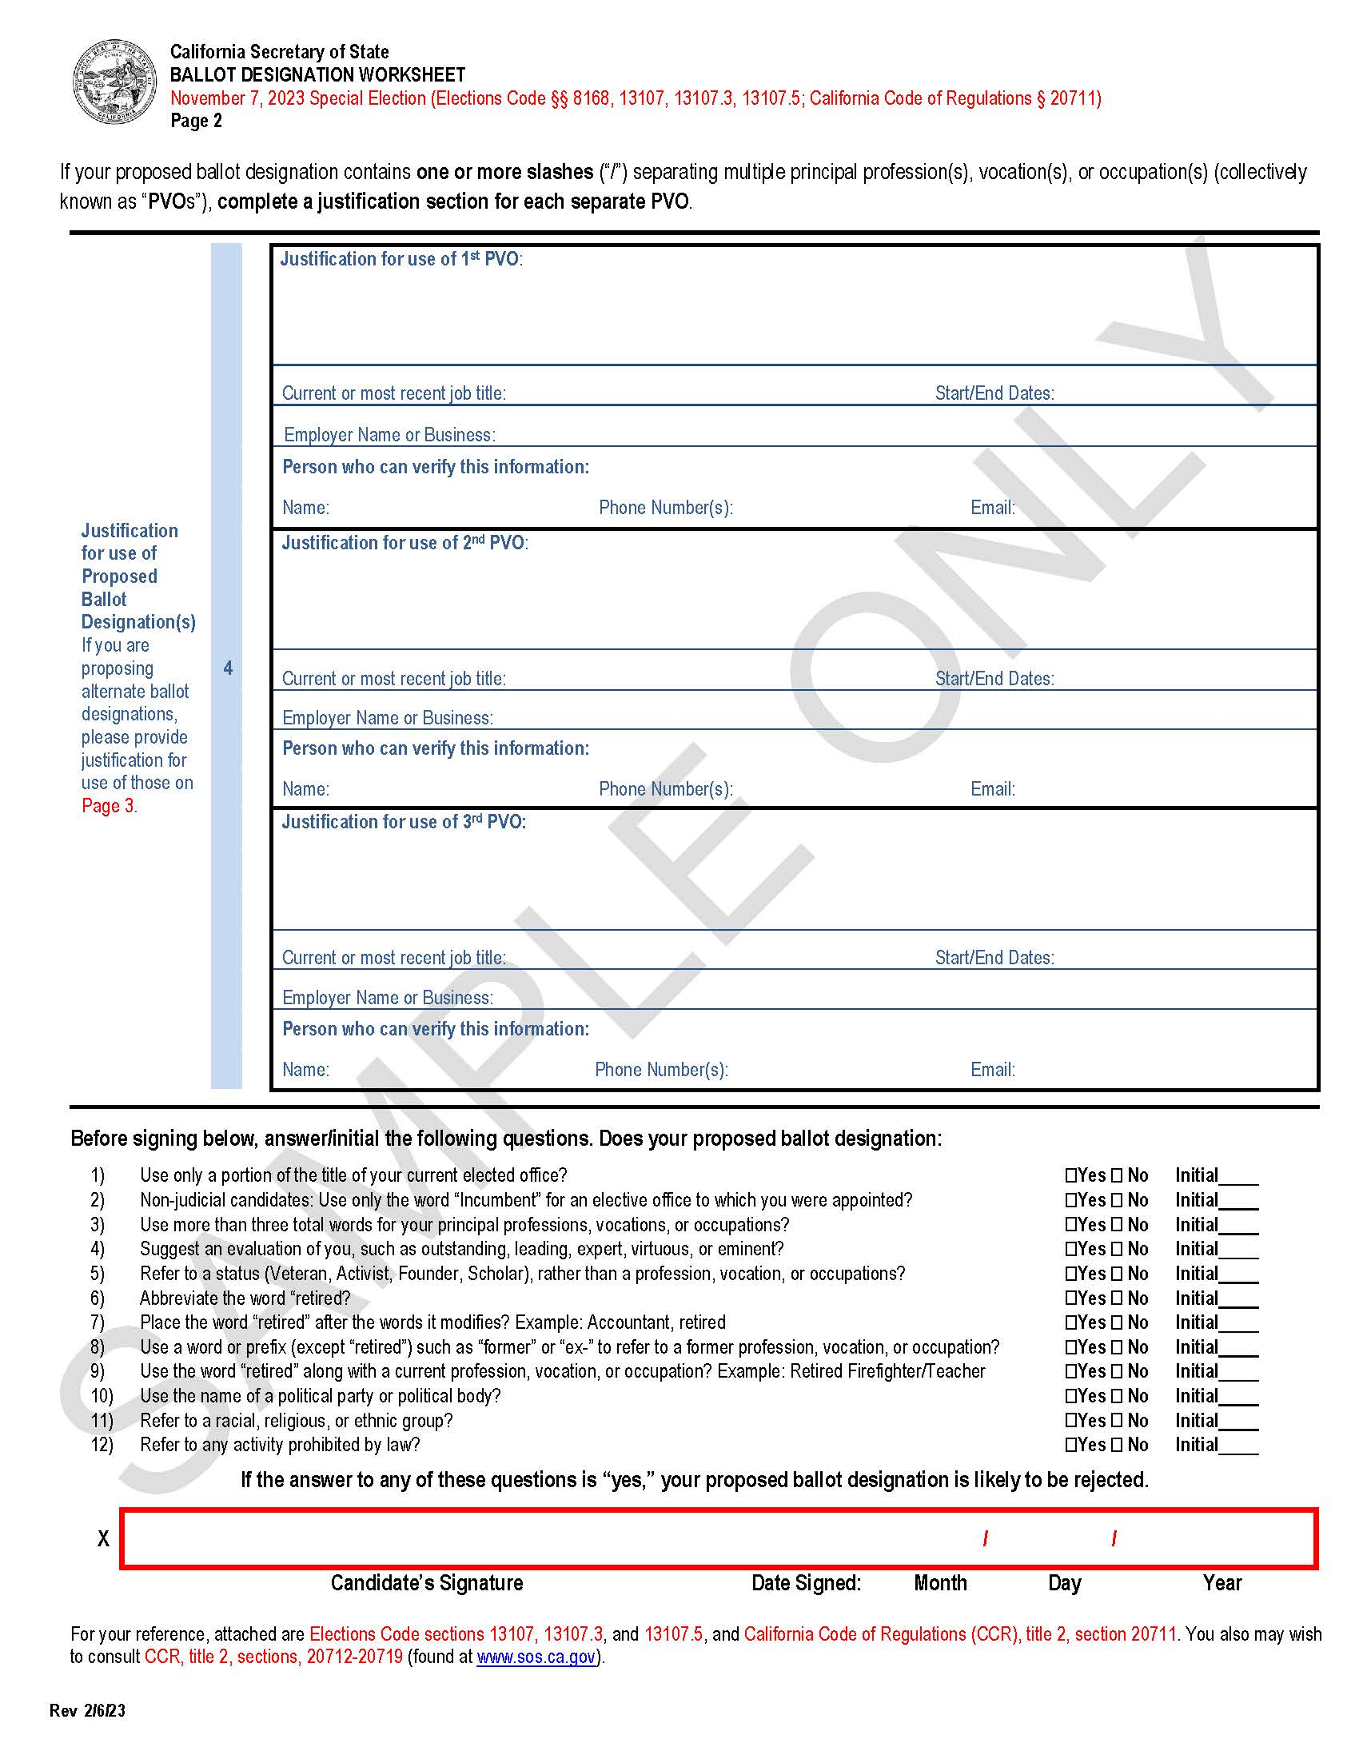
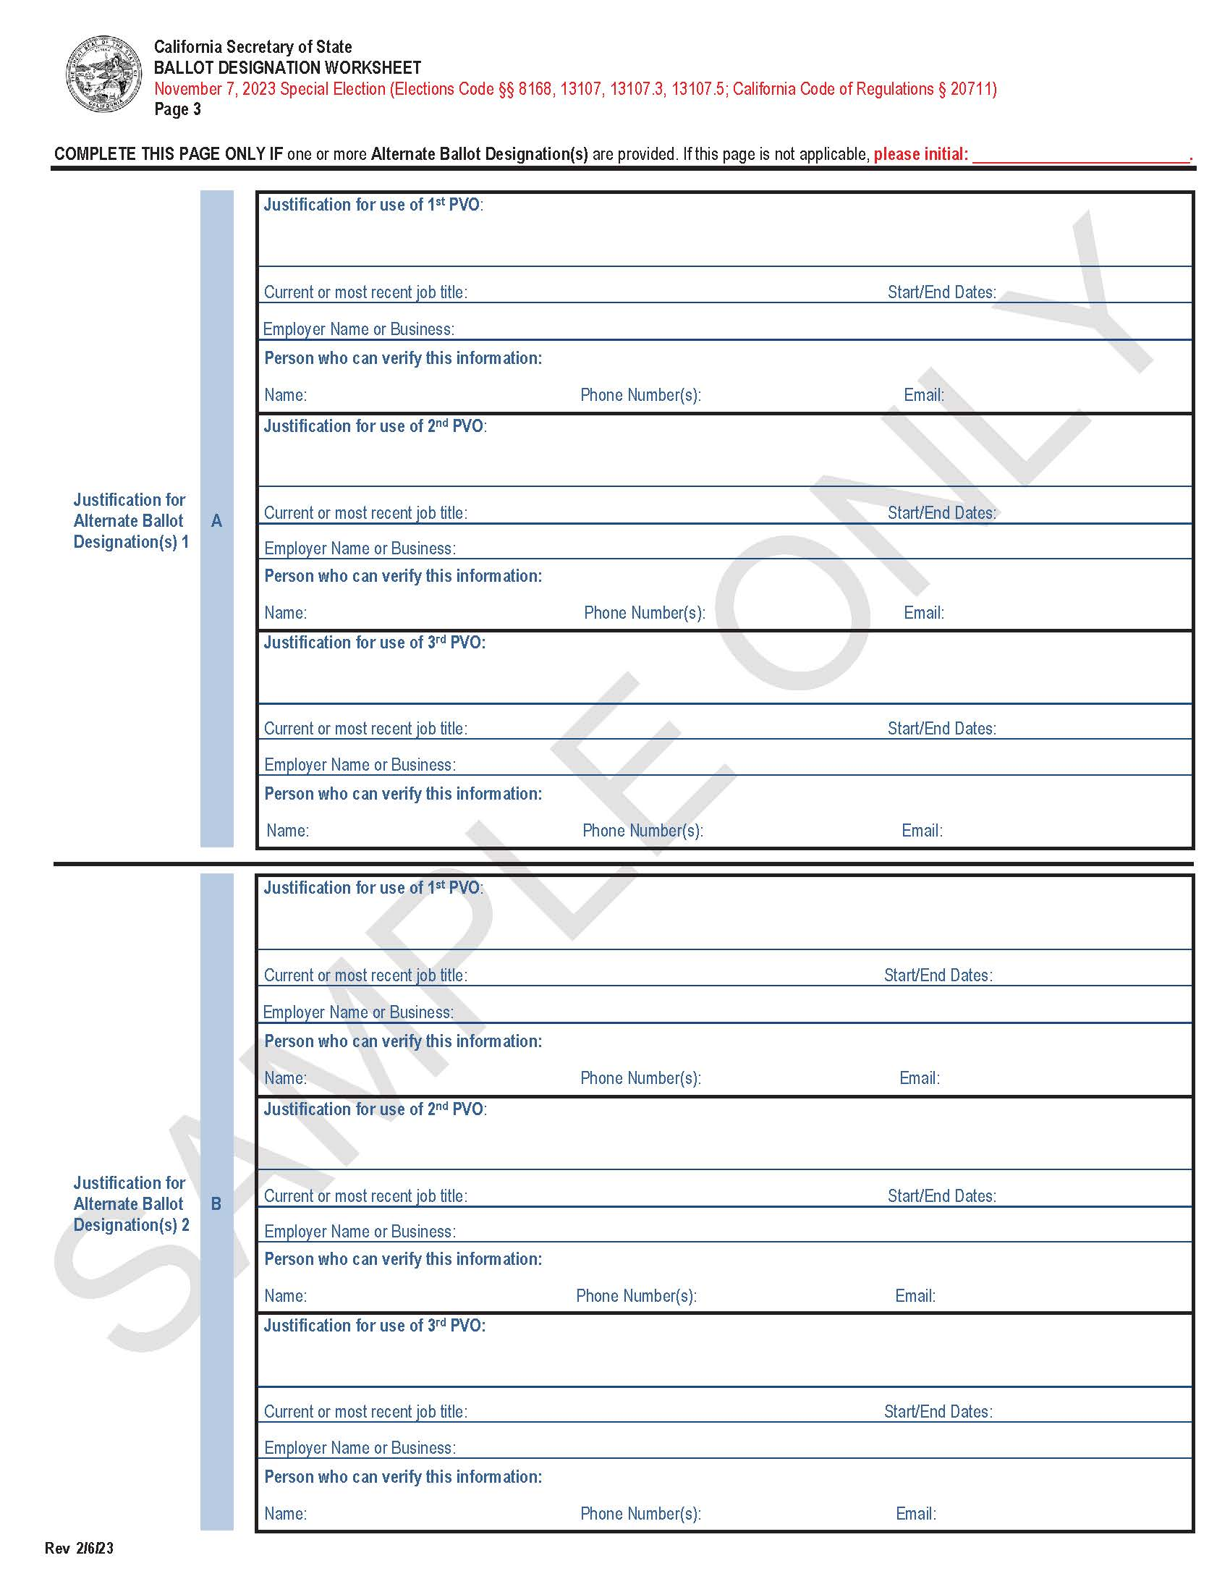
Ballot Designation Worksheet (continued)
Notes:
bren’s Slide:
Here is an example of the ballot designation worksheet. You’ll notice at the top of page 1 that the worksheet provides for specific instructions as follows:
“This entire form must be completed, or it will not be accepted, and you will not be entitled to a ballot designation. DO NOT LEAVE ANY SPACES BLANK. If information requested is not applicable, please write “N/A” or use a dash in the space provided, otherwise the information MUST be provided. Please keep in mind that UPON FILING THIS WORKSHEET, THE DOCUMENT WILL BECOME A PUBLIC RECORD.
Please ensure that all candidate and attorney information is filled out completely. If any spaces are left blank such as for a mailing address or email address, then enter “N/A” or use a dash – do not leave a space blank.
Additionally, on page 1 you’ll find a section to add a proposed ballot designation and two alternative designations. Please add at least three designations. If a proposed designation does not comply with the elections code, we will review the 1st alternate, and if necessary, the 2nd alternate designation, and choose which designation to be used, then provide notification to the candidate which designation was selected.
Most important to remember is to fill out, in detail, justification for the proposed and alternate designations. For each designation, the candidate will have three opportunities to justify why they would like to use the designation. For instance, if the candidate is using Lawyer Accountant Father, as the proposed designation, fill out all three sections on page 2 to justifying why each of the individual words in the designation is considered your principal profession, vocation or occupation.
Provide job titles, start and end dates, employer information, and who the ROV might call to verify this information.
At the bottom of page 2, consider filling out the checklist of the 12 questions that will assist with determining if the designation is eligible, then sign and date the form.
*Complete page 3 only if one or more Alternate Ballot Designations are provided. Use this page to write the justification for both Alternate Ballot Designations 1 and 2 in the same manner as for the Proposed Ballot Designation on page 2. If this page is not applicable, initial at the top right corner.

Slide 21
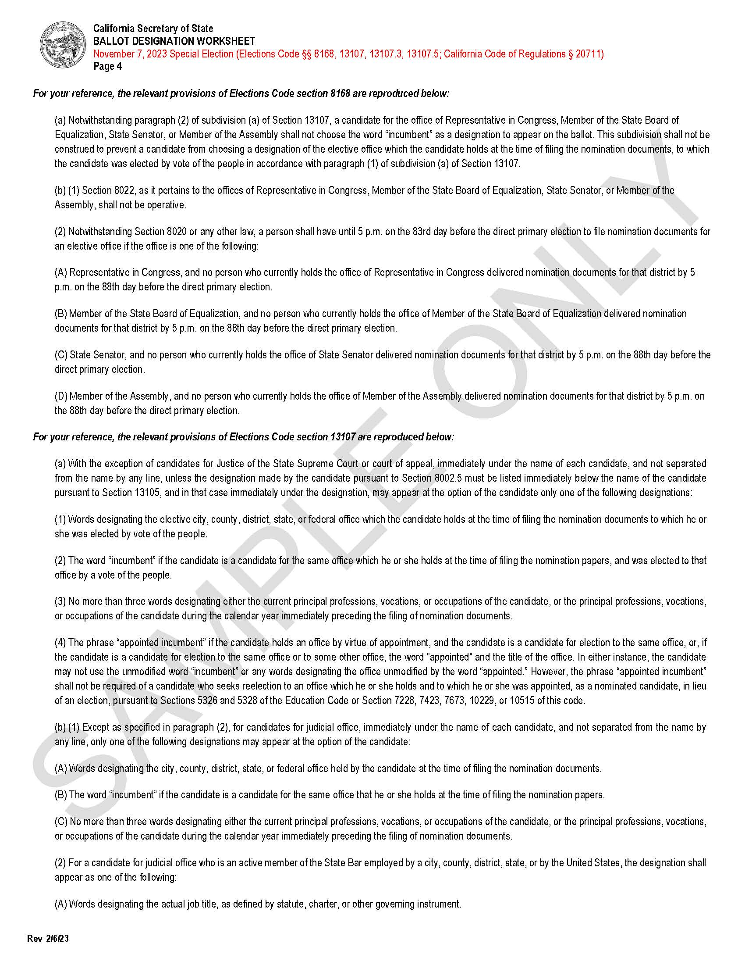
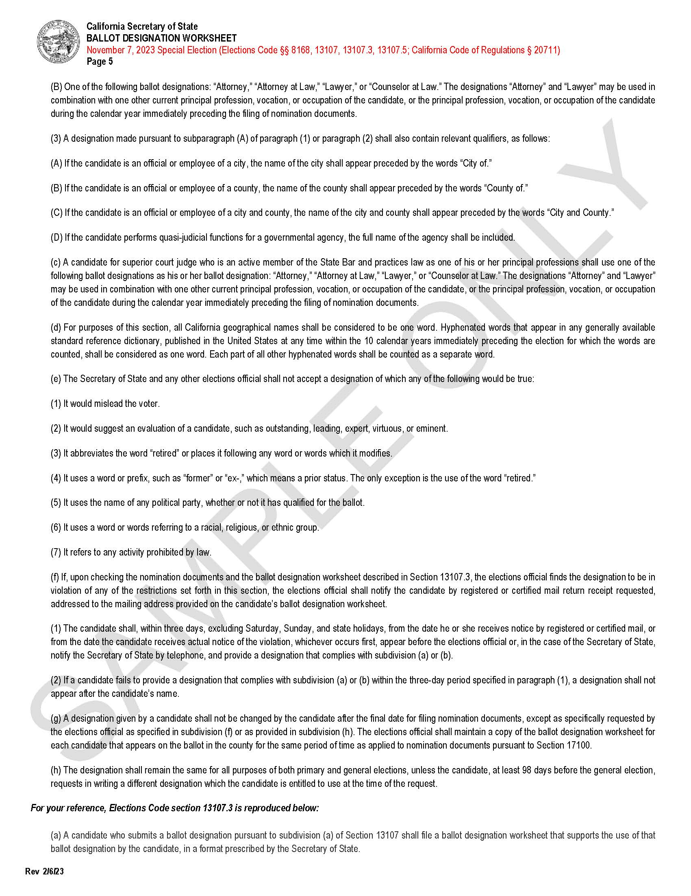
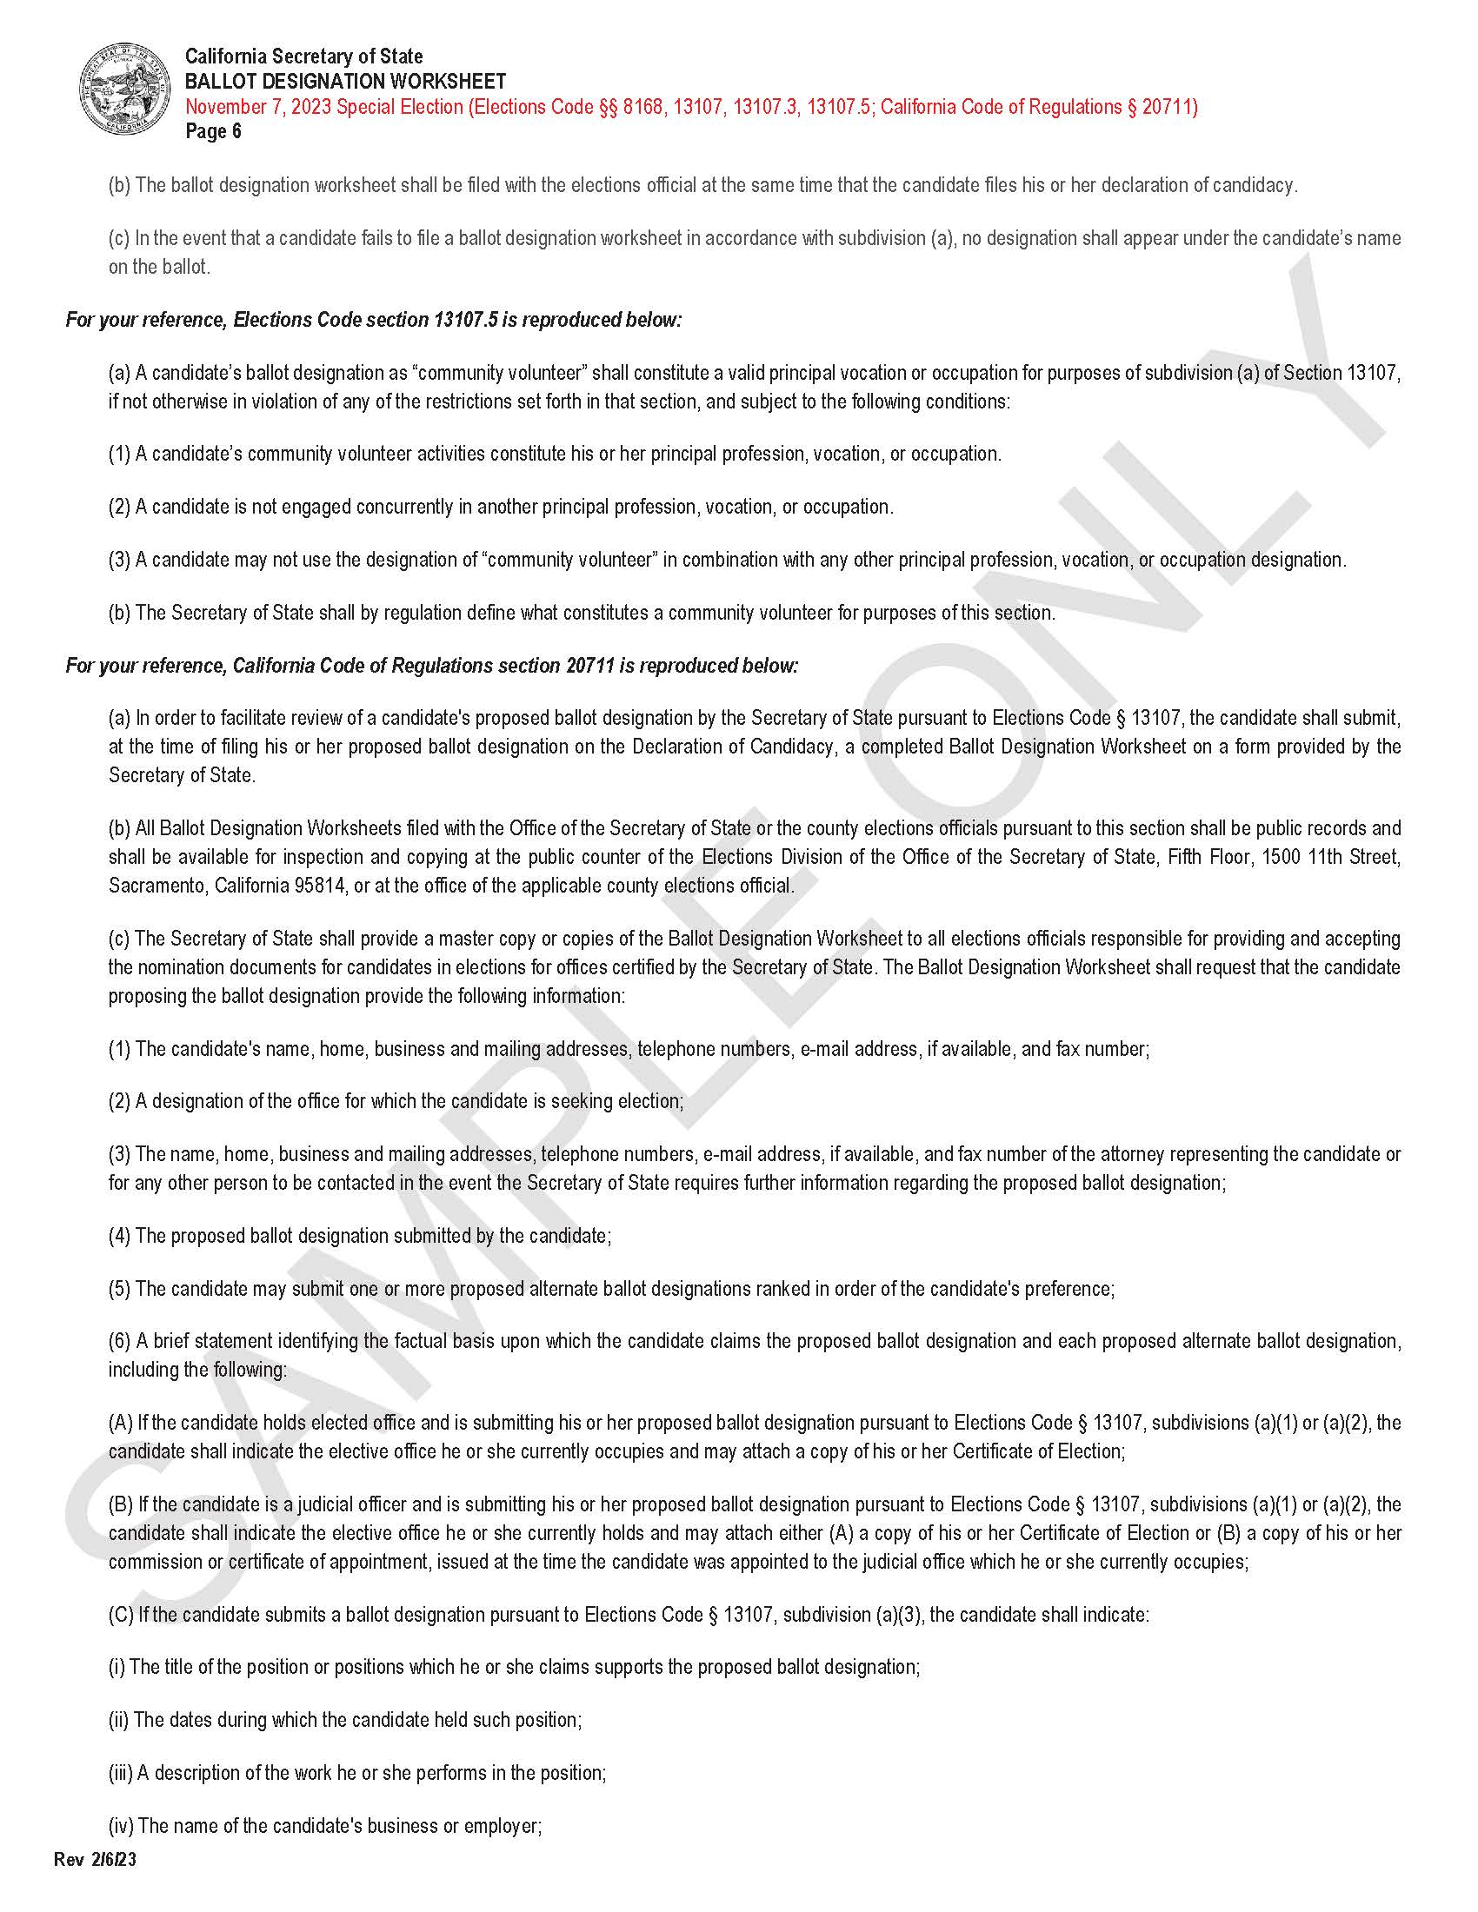
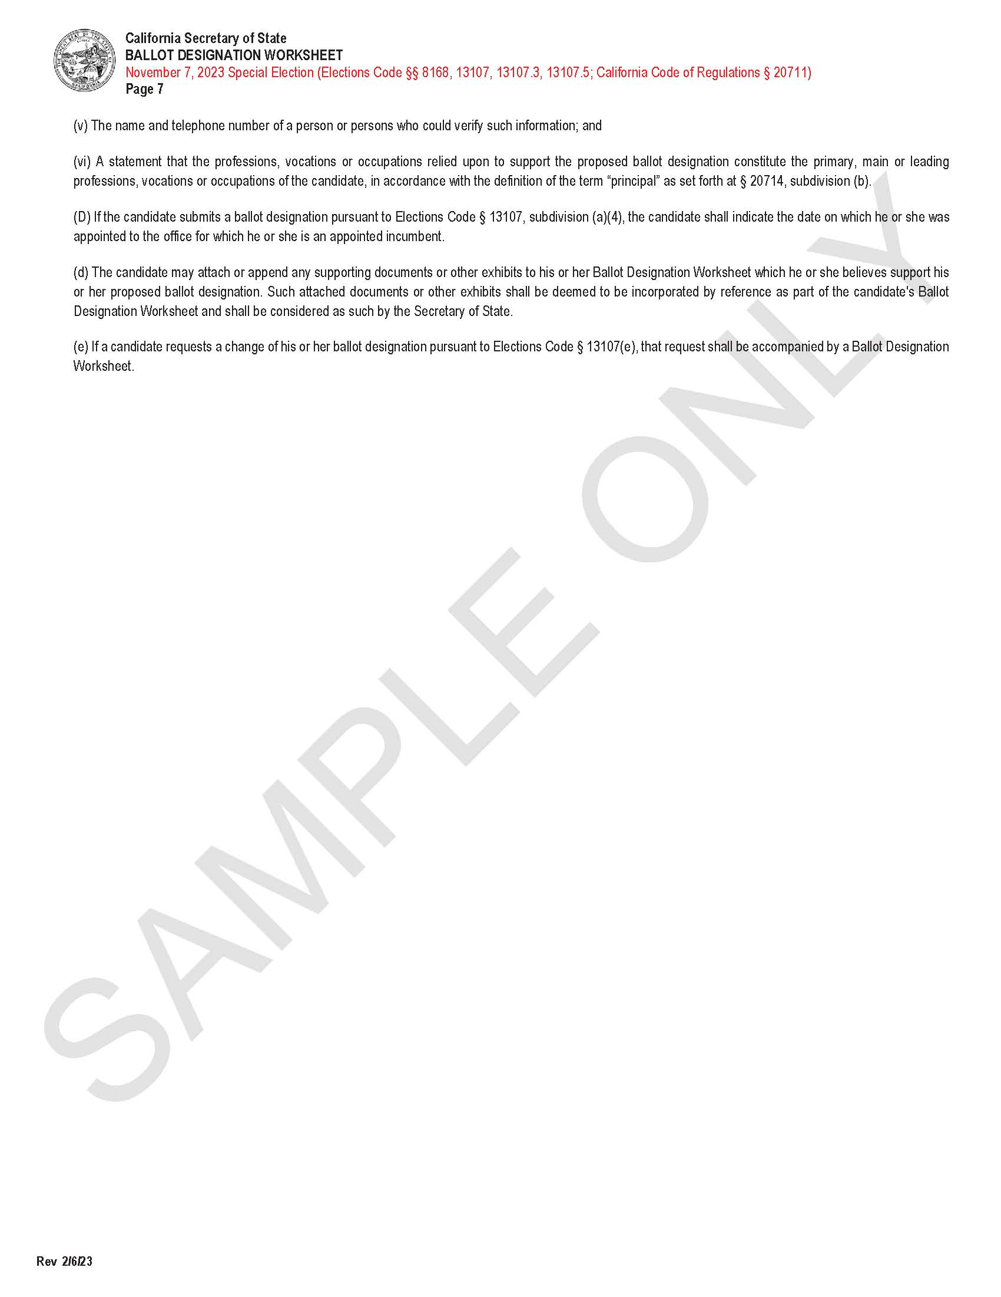
Ballot Designation Worksheet (continued)
Notes:
bren’s Slide:
On the ballot designation worksheet, pages 4, 5, and 6 a candidate will find additional information and instruction on how to fill out the worksheet so please be sure to read through all pages to ensure the worksheet is filled out in its entirety. On page 4, section 13107(a)(b)(c), a candidate will find election related information pertaining specifically to judicial contests.

Slide 22
This Photo by Unknown Author is licensed under CC BY-SA
Notes:
BREN’S SLIDE:
At this point, I’d like to check if there are any questions? If none, then I’ll share information related to the Petition for Write-in Campaign.

Slide 23
Petition for Write-in Campaign (Primary Election)
As discussed earlier, if the incumbent is the only candidate to have filed nomination documents for the office of superior court judge, the contest shall not appear on the March 5, 2024 Presidential Primary election ballot unless the following occurs:
If within 10 days of the filing deadline for the Presidential Primary election a petition is submitted to the county elections office that:
Indicates a write-in campaign will be conducted for the office; and,
The proponent has collected enough signatures, signed by at least 0.1% of the registered voters qualified to vote with respect to the office; and,
Provided that the petition contains at least 100 signatures but not contain more than 600 signatures; then…
…the incumbent judge’s name will be “forced” onto the March 5, 2024 Presidential Primary election ballot to allow for a write-in candidate.
The ROV will notify the candidate in the event a petition has qualified in this regard.
Notes:
BREN’s Slide:
As discussed earlier, if the incumbent is the only candidate to have filed nomination documents for the office of superior court judge, the contest shall not appear on the March 5, 2024 Presidential Primary election ballot unless the following occurs:
If within 10 days of the filing deadline for the Presidential Primary election a petition is submitted to the county elections office that:
Indicates a write-in campaign will be conducted for the office; and,
The proponent has collected enough signatures, signed by at least 0.1% of the registered voters qualified to vote with respect to the office; and,
Provided that the petition contains at least 100 signatures but not contain more than 600 signatures; then…
…the incumbent name will be “forced” onto the March 5, 2024 Presidential Primary election to allow for a write-in campaign.
The ROV will notify the candidate in the event a petition has qualified in this regard.

Slide 24
Petition for Write-in Campaign (General Election)
Additionally, if the incumbent is the only candidate to have filed nomination documents during the primary election for the office of superior court judge, the contest shall not appear on the November 5, 2024 Presidential General election ballot unless the following occurs:
If by not less than 83 days before the general election a petition is submitted to the county elections office that:
Indicates a write-in campaign will be conducted for the office; and,
The proponent has collected enough signatures, signed by at least 0.1% of the registered voters qualified to vote with respect to the office; and
Provided that the petition contains at least 100 signatures but not contain more than 600 signatures; then…
… the incumbent judge’s name will be “forced” onto the general election ballot if it has not yet appeared on the direct primary election ballot.
Therefore, the ROV will not require the incumbent candidate to file nomination documents for the Presidential General election, but he or she has the option to submit a new Candidate Statement of Qualifications form by no later than end of the nominations period.
Notes:
BREN’s Slide:
Additionally, if the incumbent is the only candidate to have filed nomination documents during the primary election for the office of superior court judge, the contest shall not appear on the November 5, 2024 Presidential General election ballot unless the following occurs:
If by not less than 83 days before the general election a petition is submitted to the county elections office that:
Indicates a write-in campaign will be conducted for the office; and,
The proponent has collected enough signatures, signed by at least 0.1% of the registered voters qualified to vote with respect to the office; and
Provided that the petition contains at least 100 signatures but not contain more than 600 signatures; then…
… the incumbent name will be “forced” onto the general election if it has not yet appeared on the direct primary election.
Therefore, the ROV will not require the incumbent candidate to file nomination documents for the Presidential General election, but he or she has the option to submit a new Candidate Statement of Qualifications form by no later than end of the nominations period.

Slide 25
Scenario 1 – OFF BALLOT
March 5, 2024 Presidential Primary Election
Incumbent Runs Unopposed
Incumbent is OFF BALLOT
No Other Candidates Run
No Appointments Made
No Petitions Filed
November 5, 2024 Presidential General Election
Incumbent is OFF BALLOT and is Elected for a 6-Year Term
March 5, 2024 Presidential Primary Election
Incumbent will be ON BALLOT with any qualified Write-In candidate(s), if…
1) The incumbent runs opposed against one or more candidate(s) for that contest; OR,
2) A candidate is appointed by the Governor prior to the Presidential Primary Election; OR,
3) A candidate, other than the incumbent, runs solely or with one or more other candidates for that contest; OR,
4) Within 10 days following the filing deadline for the Presidential Primary Election, a qualifying petition is filed to force a judicial name to the ballot to allow for a write-in campaign.
November 5, 2024 Presidential General Election
Incumbent is ON BALLOT with any qualified Write-in Candidates when a qualifying petition is filed by no less than 83 days prior to Presidential General election and the candidate’s name was not on the direct primary election.
Scenario 2 – ON BALLOT
Notes:
BREN’s Slide:
On this slide you’ll find two examples of information we spoke about in the previous slides.
Scenario 1 provides an example of how a judicial name will remain off ballot for both the direct primary and general elections.
Scenario 2 provides an example of how a judicial name might appear on ballot due to an incumbent running opposed, a candidate who has been appointed by the Governor, a candidate other then the incumbent runs solely or with one or more candidates for that contest, or a qualifying petition is filed with the ROV 10 days following the filing deadline for the direct primary election or no less than 83 days prior to the general election.

Slide 26
This Photo by Unknown Author is licensed under CC BY-SA
Notes:
BREN’S SLIDE:
At this point, I’d like to check if there are any questions? If none, then I’ll pass it on to Election Specialist Cassandra Hevia who will share information related to Other Nomination Documents.

Slide 27
Other Nomination Documents:
Candidate Information Request Form
Preferred Transliteration Form (Required to File)
Vietnamese Name Accents Form (Optional to File)
Code of Fair Campaign Practices Form (Optional to File)
Department of Transportation – Statement of Responsibility Form (submitted to the State by the Candidate)
FPPC Form 501 (Required to File)
FPPC Form 700 (Required to File)
Notes:
Cassandra’s Slide:
Thank you, Bren…
We’ll now move on to discuss other nomination documents that will be issued and filed during the nomination period…

Slide 28
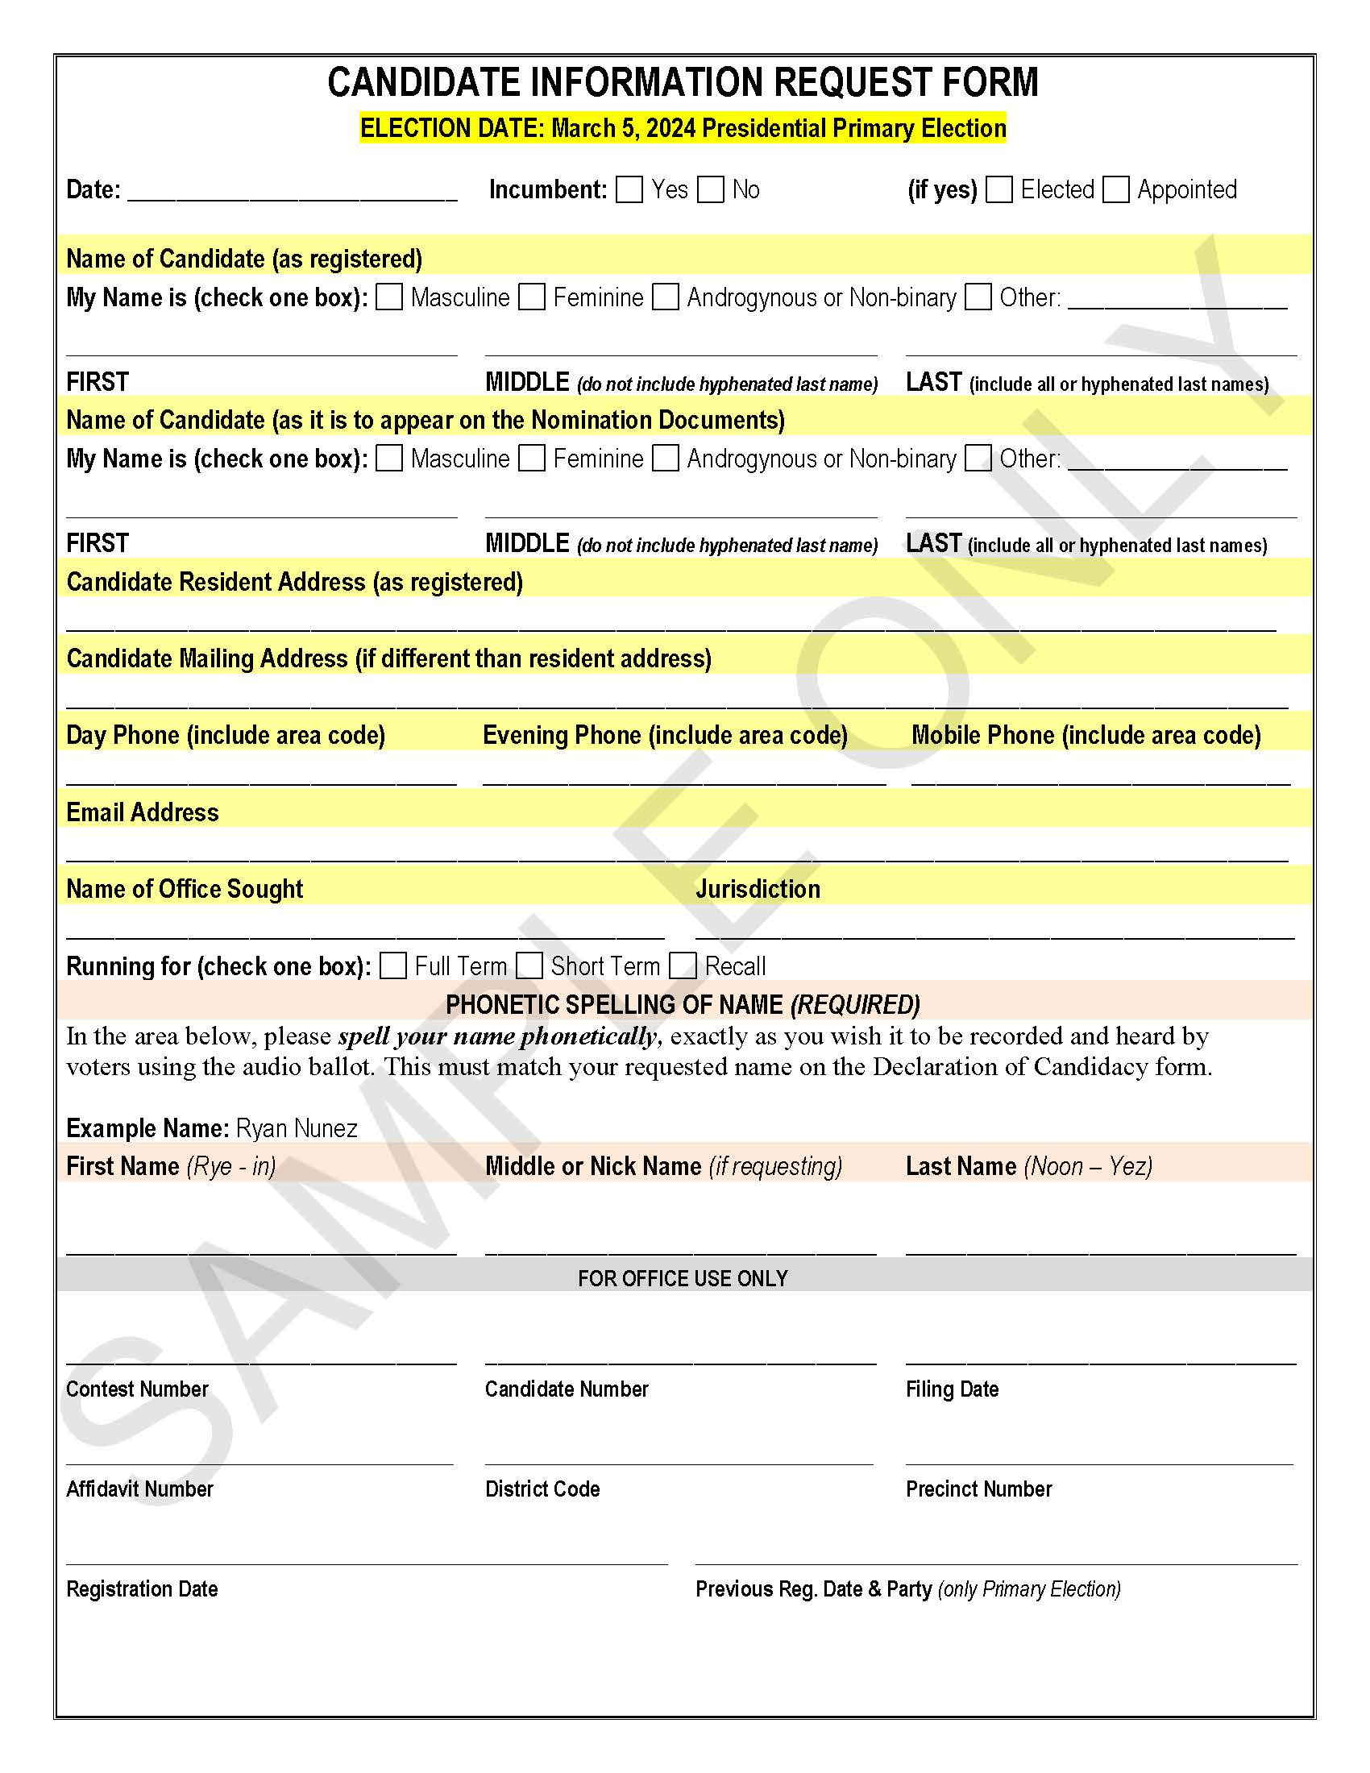
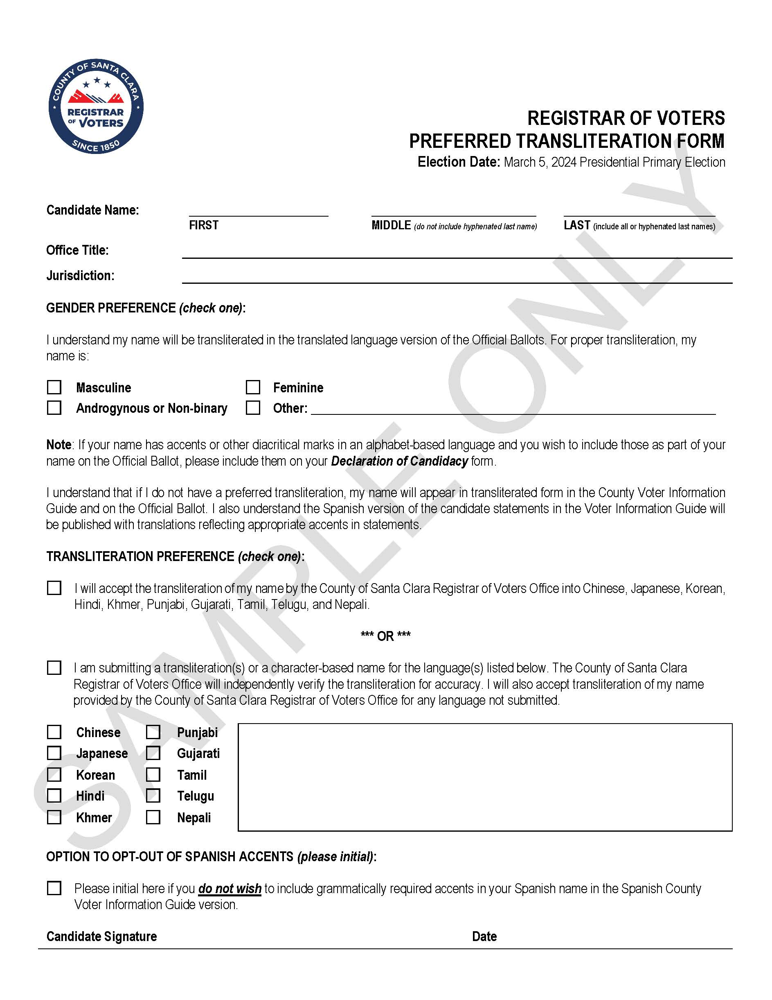
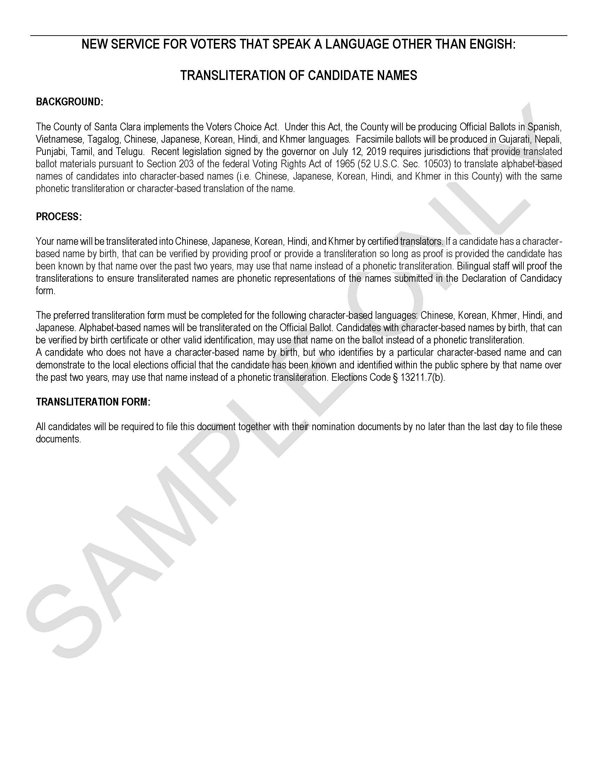
Candidate Information Request Form (CIRF) Preferred Transliteration Form
Notes:
Cassandra’s Slide:
The Candidate Information Request Form is required to be filed with other nomination documents to ensure ROV staff can receive information such as name, residence or mailing address, other contact information, and phonetic spelling of a candidate’s name. Candidates will receive this form well in advance of other forms which will help us begin the process of verification and eligibility as well as confirm certain candidate data that will be entered into our database.
Candidates who have a character-based name, an optional form to fill out would be the Preferred Transliteration form to allow our Ballot Layout Division to understand best what format the candidate would like their name transliterated on the ballot. The candidate can choose to accept the transliteration of their name provided by the ROV or submit for consideration their own transliteration that the ROV will independently verify.
Additionally, that candidate has a choice to accept or opt-out of any translations in Spanish and Vietnamese that include the appropriate accents in candidate statements.
In order to ensure the name of the candidate is transliterated properly on the ballot, the candidate will need to check if he or she would like their name formatted in masculine/feminine/androgenous/non-binary/or another format.
Also, if the candidate’s name has accents or other diacritical marks in an alphabet-based language and the candidate wishes to include those as part of their name on the Official Ballot, please also include that information on the Declaration of Candidacy form.

Slide 29
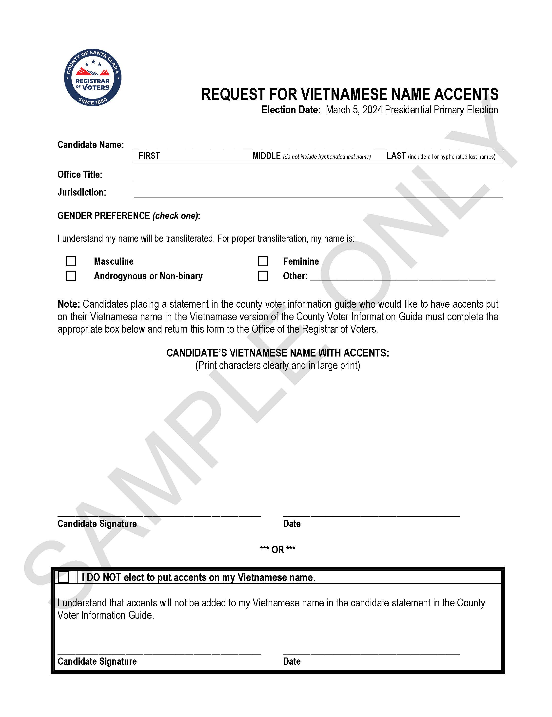
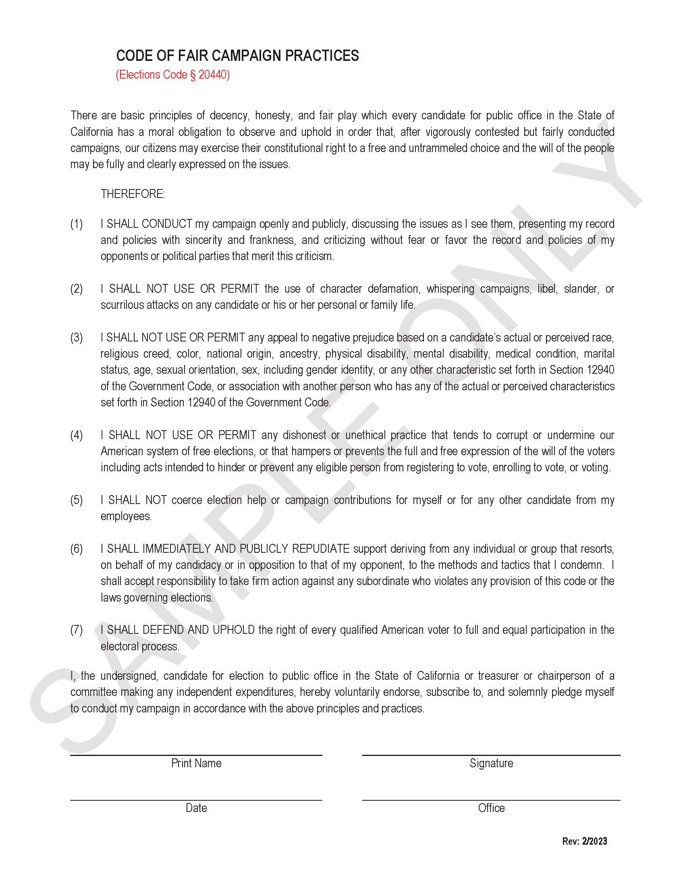
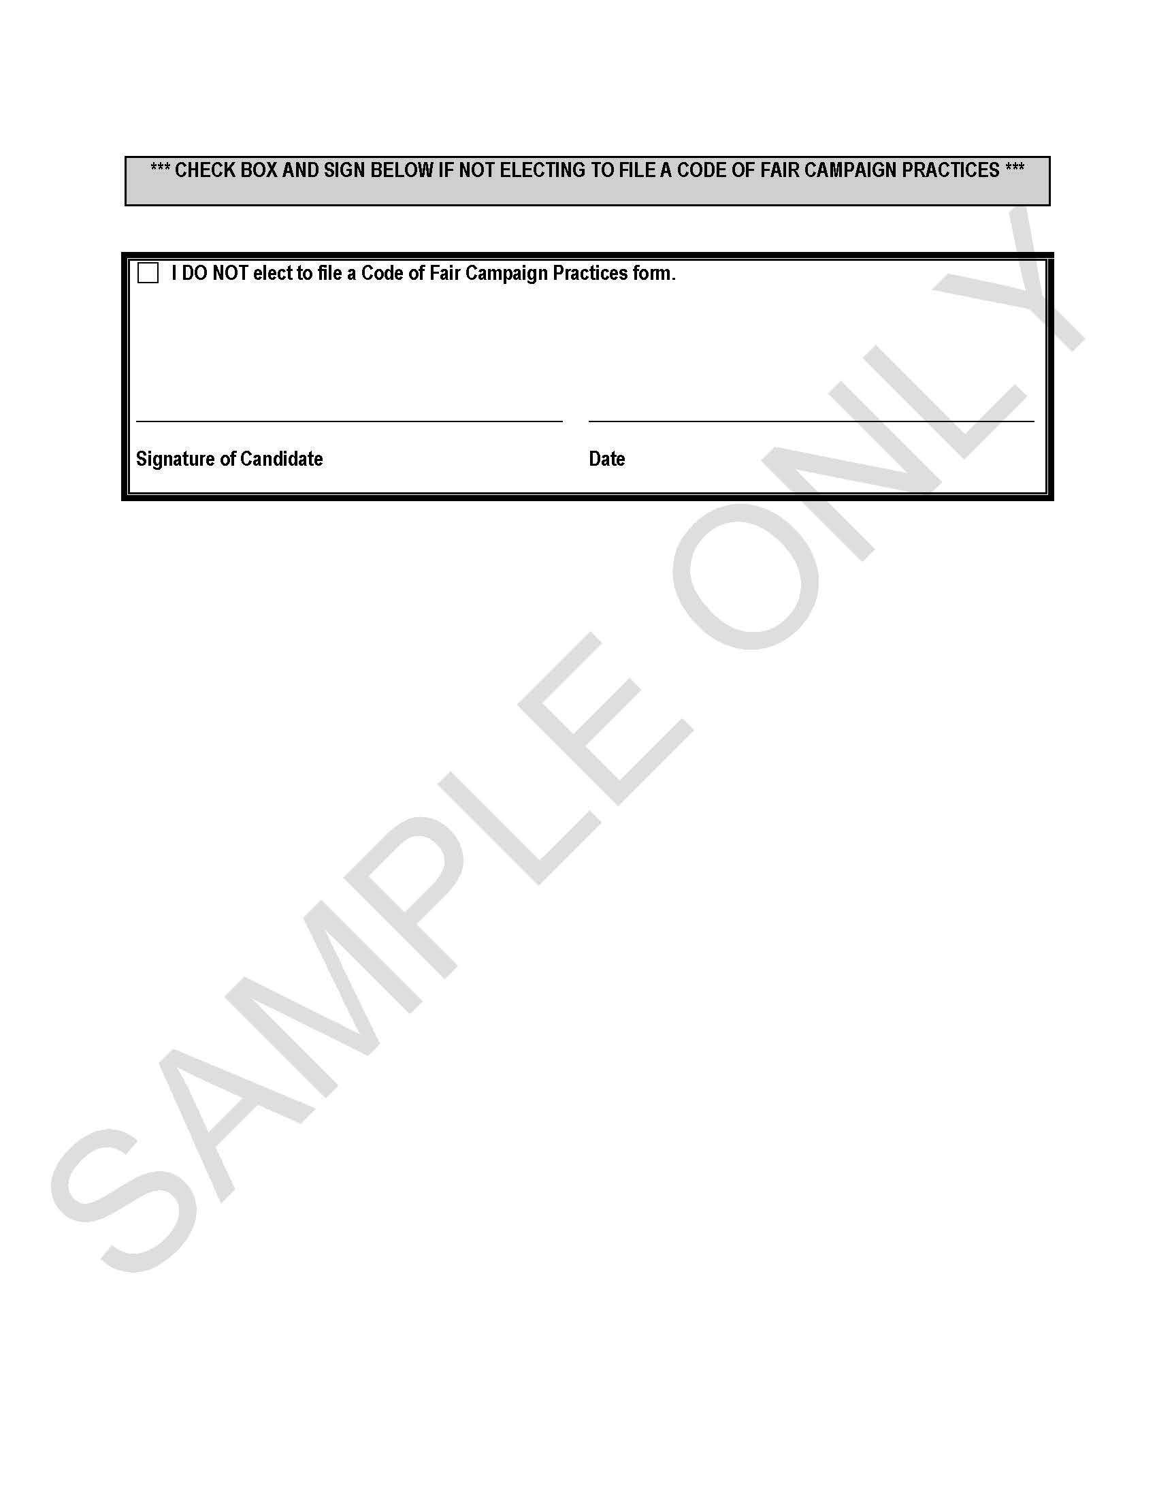
Vietnamese Name Accent Form Code of Fair Campaign Practices Form
Notes:
Cassandra’s Slide:
The Vietnamese Name Accent form, another optional form to submit, allows for a candidate to choose what format their name should be transliterated such as masculine/feminine/androgenous/non-binary/or another format.
Candidates would provide the Vietnamese name characters with the appropriate accents on the form to be verified independently by the ROV or opt-out and accents will not be used on the Vietnamese name in the candidate statement that will be published in the County Voter Information Guide.
The Code of Fair Campaign Practices form is another optional form for a candidate to file and provides that the candidate will abide by basic principles of decency, honesty, and fair play throughout the election cycle.

Slide 30
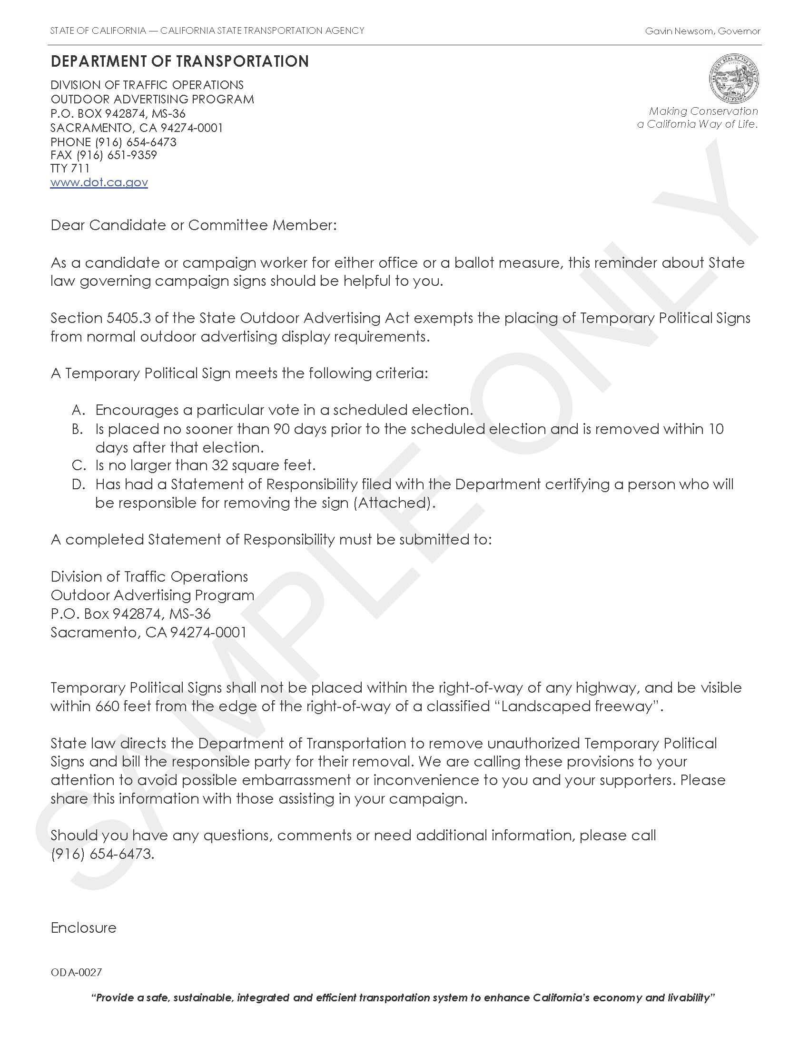
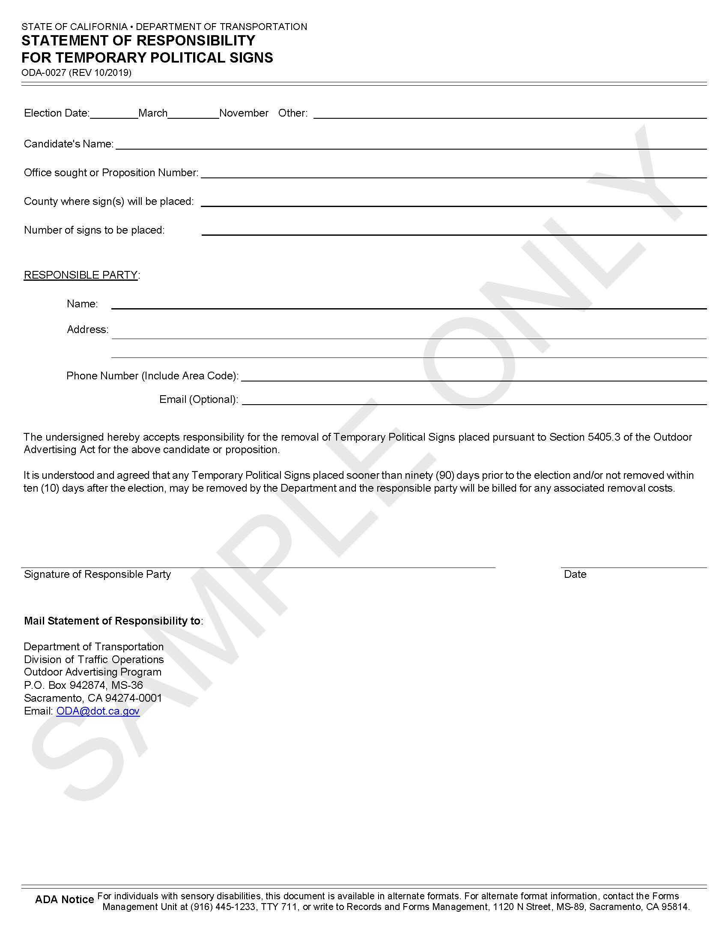
Department of Transportation Statement of Responsibility Form
Notes:
Cassandra’s Slide:
The Department of Transportation Statement of Responsibility Form is prepared by the State. This form provides instruction on when and where a candidate may place temporary political signs. Candidate’s will fill out the 2nd page providing specific information about their candidacy in the upcoming election and mail the original to the state, with a copy to be submitted to the ROV with all other nomination documents.

Slide 31
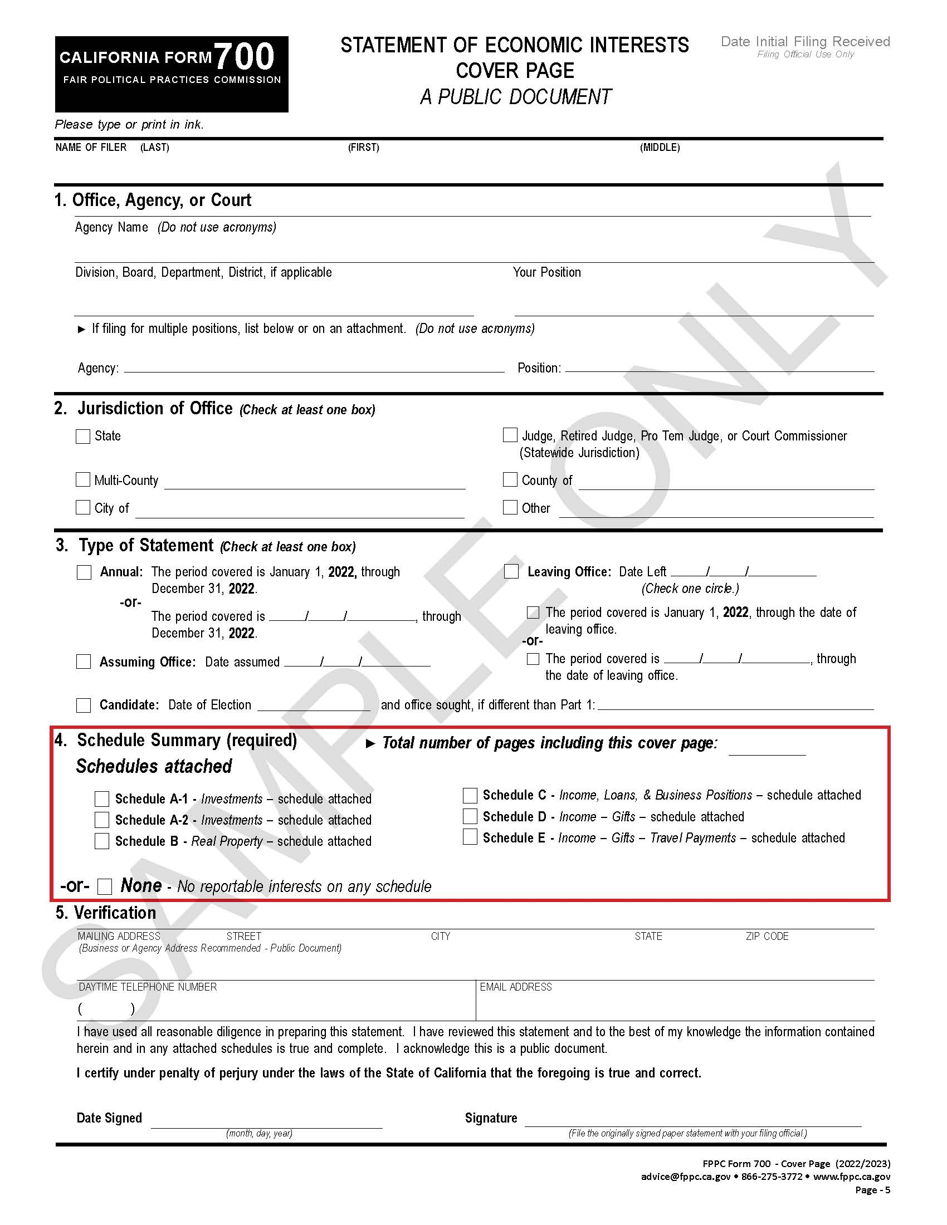
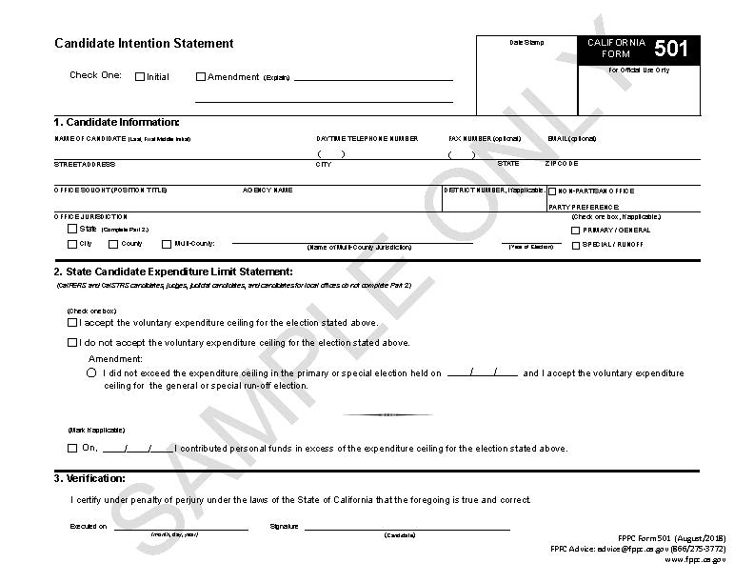
FPPC Form 501 – Candidate Intention Statement FPPC Form 700 – Statement of Economic Interests
Notes:
Cassandra’s Slide:
Lastly, you’ll need to submit Fair Political Practices Commission (FPPC) forms including a…
Candidate Intention Statement (FPPC Form 501); the candidate will only fill out sections 1 and 3. Section 2 is for state candidates. For purposes of FPPC filing requirements, judges are not considered state candidates and therefore do not need to fill out Section 2. Candidates may also fill out and submit the form at any time prior to the nomination period or file it with all other nomination documents. Instructions on how to properly fill out the form are on page 2 so please thoroughly read that page or contact our office for assistance.
Statement of Economic Interests (FPPC Form 700); the candidate will fill out all five sections of the cover page, and any schedules that apply to their reporting situation. Ensure you check the box for candidate and include the election date (March 5, 2024).
The Assuming Office Statement will be filed after the election with your filing officer.

Slide 32
This Photo by Unknown Author is licensed under CC BY-SA
Notes:
CASSANDRA’S SLIDE:
At this point, I’d like to check if there are any questions? If none, then I’ll pass it on to Elections Division Coordinator Bren Lehr who will wrap-up the presentation.

Slide 33
ROV Contacts (408) 299-8639 Preferred Email: candidateservices@rov.sccgov.org
Shannon Bushey, Registrar of Voters Shannon.Bushey@rov.sccgov.org
Virginia Bloom, Assistant Registrar of Voters Virginia.Bloom@rov.sccgov.org
Bren Lehr, Elections Division Coordinator Bren.Lehr@rov.sccgov.org
Louella Sevegan, Election Specialist Louella.Sevegan@rov.sccgov.org
Marianna Khienkina, Election Specialist Marianna.Khienkina@rov.sccgov.org
Cassandra Hevia, Election Specialist Cassandra.Hevia@rov.sccgov.org
Matt Moreles, Assistant Registrar of Voters Matt.Moreles@rov.sccgov.org
Claudia Gonzalez, Interim Elections Process Supervisor
Claudia.V.Gonzalez@rov.sccgov.org
Notes:
BREN’S SLIDE:
Thank you, Cassandra…
And, thank you judges for joining us today. We hope that this presentation has provided useful information about your candidacy. As you may already know, we have posted a video of this presentation on our website so you’ll have it as a resource when ready to file your paperwork.
If you should think of questions or need assistance with resources, please feel free to contact Candidate Services at our preferred email at candidateservices@rov.sccgov.org or call us directly at (408) 299-8639​.
At this point, I’ll open the floor to any last-minute questions before we wrap-up.
Have a great day everybody!

