Slide 1
Under the Same Dream:
Unearthing Immigrant Narratives in Santa Clara County
New American Fellowship 2023
Collaborative project between
Santa Clara County Office of Immigrant Relations
and Mosaic America

Slide 2
TODAY'S
Agenda
Welcome
About NAF
NAF 2023
Overview
Intro to Mosaic America
Immigrant Narratives & Stories in SCC
Research Project on Civic Engagement
Key Findings & Recommendations
Q&A
Sacrifice Sol by Antonio Castro

Slide 3
NAF Program Goals
Develop shared understanding on deeply rooted issues in our communities.
Understand intersections of systems of domination.
Advance professional skills.
Mentorship, coaching and career development for fellows and mentors.
Personal
Connect with communities to understand assets,
Understand how action stems from community-based research.
Growing research skills as a form of leadership development.
Professional
NAF
Inventory of community led solutions to set direction for OIR annually.
Building database of immigrant contributions, stories to influence dominant narratives.
Building sustainable community linkages among Fellows, organizations, and county through research, analysis, and policy development.
OIR
SCC
Using information and participatory processes to develop and reinforce County support for its immigrant residents.
Opportunities to mentor and to develop deeper understanding of the immigrant students’ contributions.

Slide 4
HOW WE DID IT
NAF 2023
Curriculum

Slide 5
Introducing
America
Notes:
This year's program was developed and executed in close partnership with Mosaic America. Founded by Indian immigrant women, Mosaic's mission is to foster a sense of belonging to place and strengthen social cohesion.
Mosaic's framework for understanding and mapping the cultural complexity of Silicon Valley and model for leveraging assets within cultural communities to advance equity for all is unique and groundbreaking.
To tell us more about Mosaic America and the work they have done with the Fellows this year, I'd like to introduce Usha Srinivasan - co-founder and president.

Slide 6
Social cohesion and sense of belonging are vital to diverse communities

Slide 7
Understanding cultural complexity is the first step to creating a more fair, inclusive and cohesive society

Slide 8
Understanding cultural complexity is the first step to creating a more fair, inclusive and cohesive society

Slide 9
Identifying and activating cultural assets to create shared experiences in public spaces
Increase civic engagement in all cultural communities
Foster sense of belonging, social cohesion

Slide 10
HOW WE DID IT
NAF 2023
Cultural Equity lens
Asset Mapping
Narrative StoryMaps
Social Sciences Research Methods
Connections with cultural communities

Slide 11
NAF 2023 Team
Alexandra Garcia
Researcher / Instructor
Usha Srinivasan
Advisor
Mallika Srinivasan
Project Manager
Brenda Jiang
Researcher / Instructor

Slide 12
WHAT WE DID
NAF Oral History Project
Highlight immigrant impact on society beyond labor and tax contributions.
2023 goal to add to the collection of stories from 2022, document immigrant history, but even more to track immigrant community engagement, leadership, & transformational change.
Fellows trained in social science research, process of collecting, analyzing, preserving oral histories.
Butterfly Lab, immigrant narrative training on ways to change the dominant narrative.
Theoretical framework that dives deep into the root causes of inequities, exclusions, exploitation, injustice, scapegoating, and criminalization in the U. S. immigration system. Also, it includes immigrant resilience, strength, power, engagement, leadership & innovation beyond hi-tech context.

Slide 13
Importance of Preserving History and Promoting a Complex Narrative
Stories collected contribute to a different, complex narrative about immigrants--immigrants are not here only to work, produce high-tech innovations, find safety, support families to have a better economic future, or to integrate into the U. S. institutions as they are; immigrants do struggle, but they are also resilient, strong, movement leaders, producers of transformational change.
NAF Fellows identified themes of dreaming, envisioning, and contributing to a better world; pursuing goals that are guided by equity and social justice; and of transformation/not only in personal lives, but in disrupting and rebuilding social institutions to reflect transformational change.
Recommendations how to recognize immigrant power and impact, create new institutions and avenues.
Also, how to promote real, complex, narrative about immigrants who bring new ideas, build solidarity and community, use the power of culture and art for transformation, and create best practices.

Slide 14
NAF Fellows 2023

Slide 15
Oral History Project

Slide 16
Under the Same Dream:
Dreaming
Unearthing Immigrant Narratives in Santa Clara County
Democratic ideology
Belonging & Inclusion
Equity & Justice
COMMON THEMES
Pursuing
Transforming
Differences in self-identification
VISA holders + Undocu Hardship
Societal/technical struggles
Capitalism
Advocacy
Cultural economy
Education & transformation
Community work & solidarity
Well-being

Slide 17
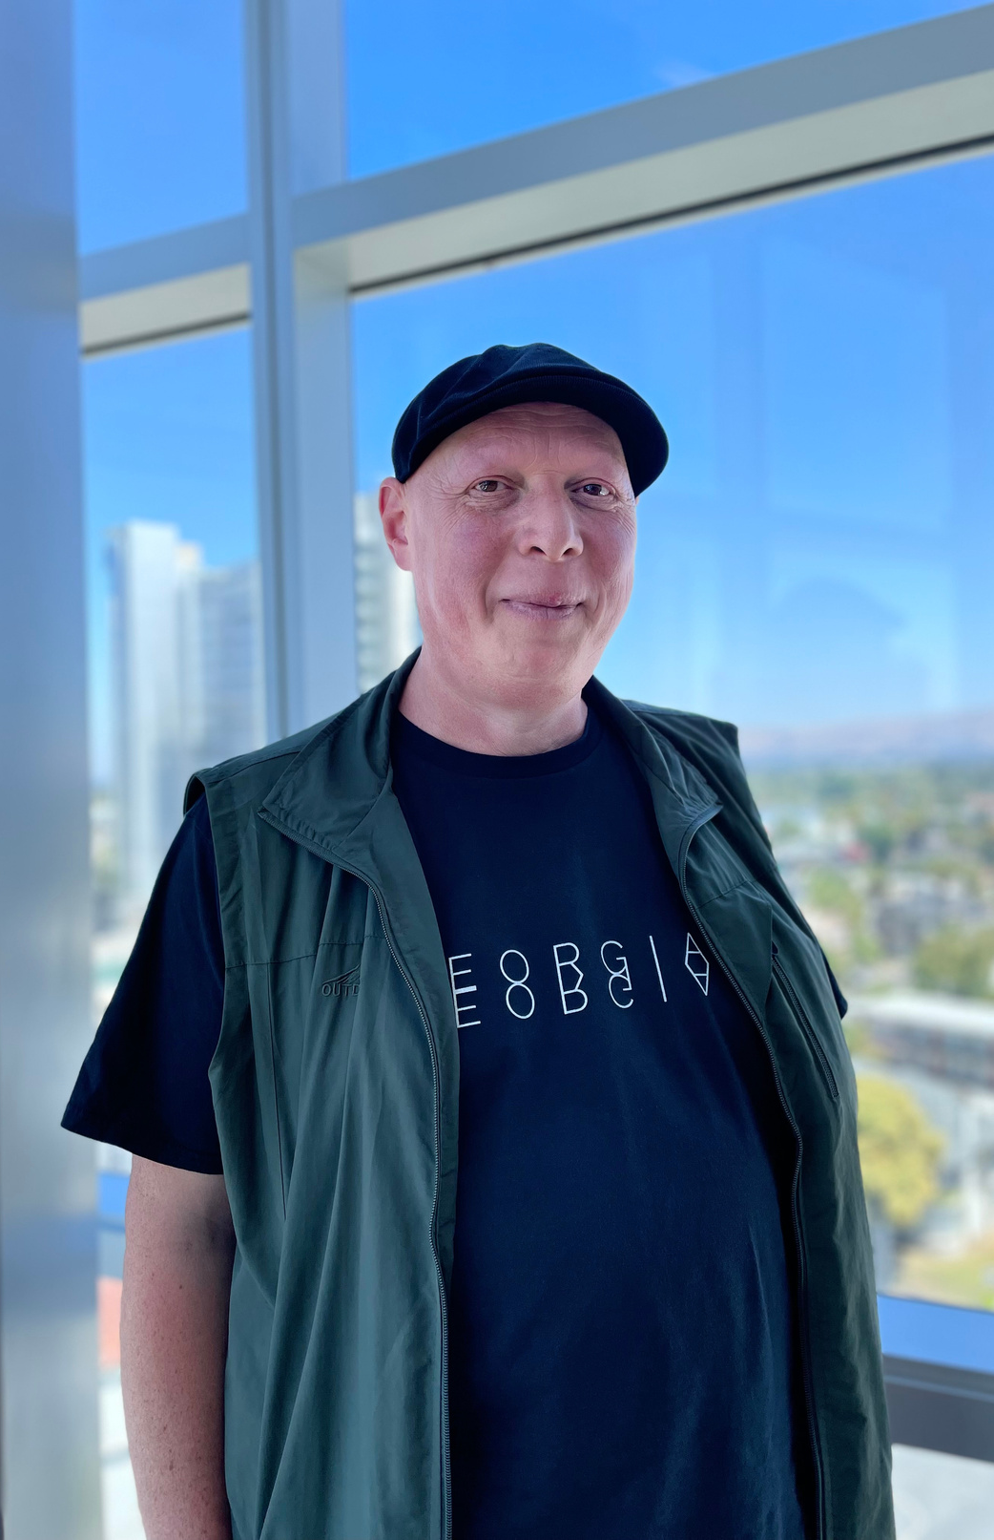
Zaza Korinteli
Tbilisi, Georgia
“American culture will be stronger if we understand each other culturally”.
“Together they can build very progressive powerful statehood”.
“Using culture to make impact is a way to create change without violence”.
Zaza's power, community engagement, and innovative thinking about a transformational change in the U. S. society
Dreaming

Slide 18
Dreaming
Andrea
Mexico
"They asked me, 'How are you so comfortable?' and I was like, 'You have to make those other people uncomfortable.' ... 'That's what you have to do, you know, with your situation, your status... being DACA has taught me to be vocal."
Andrea's leadership has a potential to disrupt the status quo in STEM and transform the way we approach mental health and well being. Her contributions reflect the power of the Dreamers' movement.

Slide 19
Pursuing
Israel P.
Mexico City, Mexico
"I offered my volunteer services to teach mathematics to GED students, aiming to assist them in completing the subject and successfully passing the test. The program attracted participants from various states including some from California, the program ensured that all attendees received the necessary support by providing subsidized housing and subsidized meals".
Israel's grassroots initiatives have opened multiple doors and showed the power of solidarity.

Slide 20
Pursuing
Vera Bates
Kenya
“I've had a few single mothers come and I don't know if this free childcare for immigrants that is offered, that is a big challenge, especially when they come while they're getting their feet in...I think the free childcare is a big deal because that has to hinder everything else.”
Vera's initiatives and strong leadership show how the innovative models based on sharing and solidarity can create transformative spaces in the society where community members truly feel supported.

Slide 21
Community Leader at
Valley Palms Unidos
Interviewee decided to remain anonymous
"Our goal is for the community to be better, to have resources, and to know where to turn in times of need."
This story shows the power of the coop movement led by immigrants. Coops have already proved their potential to radically change economic structures and disrupt capitalist exploitation. Coops are spaces where "democracy at work" is present. This movement is about economic justice, workers' rights, and all other aspects of social justice.
Transforming

Slide 22
Transforming
Protima
India
Protima came to the US in August of 2000, for personal reasons, but also to pursue a masters in law. Since then she has worked hard to bring about change through her advocacy and community work.
“I feel most whole, complete, and respected as a human when I'm in India, because nothing in this country has gone to the extent of telling me that I belong.”
Protima's example shows leadership in the women's rights movement, prison reform, immigrant justice, and overall disruption of patriarchal structures.

Slide 23
Farima
Iran
Transforming
Farima, a resilient and talented soul, embarked on a courageous journey with her Mother from Iran’s shores to the United States. Seeking refuge in the wake of the Iranian Revolution.
Founder and Artistic Director of the Simorgh Dance Collective.
"[Dance] It's a beautiful way to show our community who we are—to say, 'We exist. We are here. We're not aliens.
We're human".
Farima's story reflects her visionary work of claiming artistic spaces to connect on a deep human level, rebuild social power, to transcend all borders and hierarchies.

Slide 24
Civic Engagement Research Project
Focusing on 6 Culturally Distinct Communities in Santa Clara County

Slide 25
OUR GOAL
Project
Objectives
The project seeks to understand the factors influencing civic engagement and voter turnout in immigrant communities in SCC and propose potential strategies for improvement

Slide 26
Approach
BACKGROUND RESEARCH
COMMUNITY
INPUT
INSIGHTS & RECOMMENDATIONS
ANALYSIS
Interviews of community advocates, leaders, and county officials
Qualitative Analysis
Clean Transcripts
Writing Prompts
Selecting Key Findings
Forming conclusive recommendations
Data
Factors
Success stories
Organizational landscape

Slide 27
ISSUE
Civic Engagement among Latine and AAPI is lower than rest of the population. This has real impact on the well-being of immigrants from those racial groups.

Slide 28
Race is just a starting point
Example: AAPI includes people of 70+ ancestries, speaking over 50 languages

Slide 29
Latine Example

Slide 30
StoryMap

Slide 31
Civic Engagement
Research Project
Dominant narratives around Immigrant Civic Engagement are simplistic and inaccurate
Key Findings
Communication models, English proficiency and language isolation vary by backgrounds. New avenues for engagement are available through WeChat, Whatsapp, etc.
Assets exist within every cultural co﻿mmunity - people, places, organizations and institutions that sustain, nurture and advocate for them.
Collective information gathered from interviewees with Mosaic America have highlighted the following:

Slide 32
Low Youth Civic Literacy disproportionately impacts readiness of young voters in immigrant communities
Civic Engagement
Research Project
Key Findings
Grassroots Organizing is important to show communities their voice matters.
Campaigns cannot be solely relied on to mobilize voters. Outsiders don't engage effectively.
Citizen Boards and Commissions lack immigrant representation due to limited outreach and cumbersome requirements.
Collective information gathered from interviewees with Mosaic America have highlighted the following:

Slide 33
IMMIGRANTS BUILD THEIR OWN SAFE SPACES for people who look and experience life the way they do.
Immigrant Stories
Key Findings
IMMIGRANT MENTAL HEALTH and the feeling of being an immigrant whether documented or not, bring forth unique struggles and barriers.
Collective information gathered from interviewees with OIR have highlighted the following:
INTERVIEWEES FOUND WAYS TO CHANGE their community.

Slide 34
SHARING AND PERSERVING OF CULTURE is highly important for newly immigrated and settled immigrants in the county.
Immigrant Stories
Key Findings
BEST PRACTICE MODELS EXIST in the county already. Programs like VPU, and Promotores are highly successful.
Collective information gathered from interviewees with OIR have highlighted the following:

Slide 35
Intention
Recommendation
Recognition & Understanding of Cultural Complexity
Establish an immigrant
commission and implement supports
Increase Sustained & Strategic
Outreach to Communities
Expand Promotora Programs
and Broaden Scope of Their Work

Slide 36
Intention
Recommendation
Increase coordination between organizations
focused on increasing voter literacy
Promote Voter Education and cohesion between groups
Increase funding to community specific orgs
that focus on civic leadership
Increase opportunities
for civic leadership

Slide 37
Thank you
Together we can expand our understanding of what it means to engage civically.
The stories we tell today allow us to imagine different stories for the future.
Now, Q&A

