Slide 1
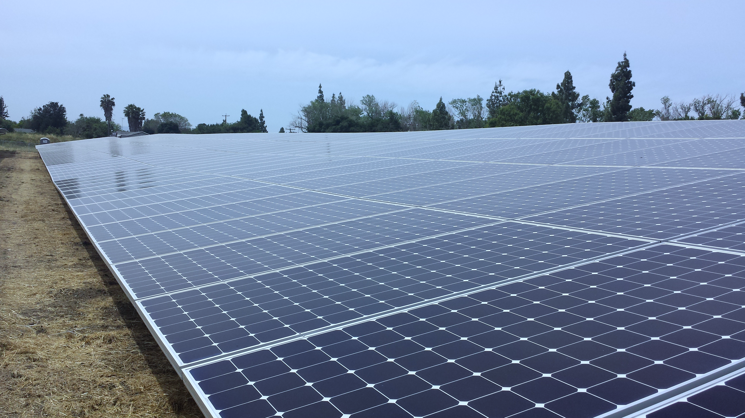
COUNTY OF SANTA CLARA SOLAR PV PROJECT
DESIGNED AND CONSTRUCTED BY SUNPOWER
COMMUNITY MEETING
Pearl Avenue Branch Library- 4270 Pearl Ave, San Jose, CA 95136
July 12, 2016, 5PM – 8PM

Slide 2
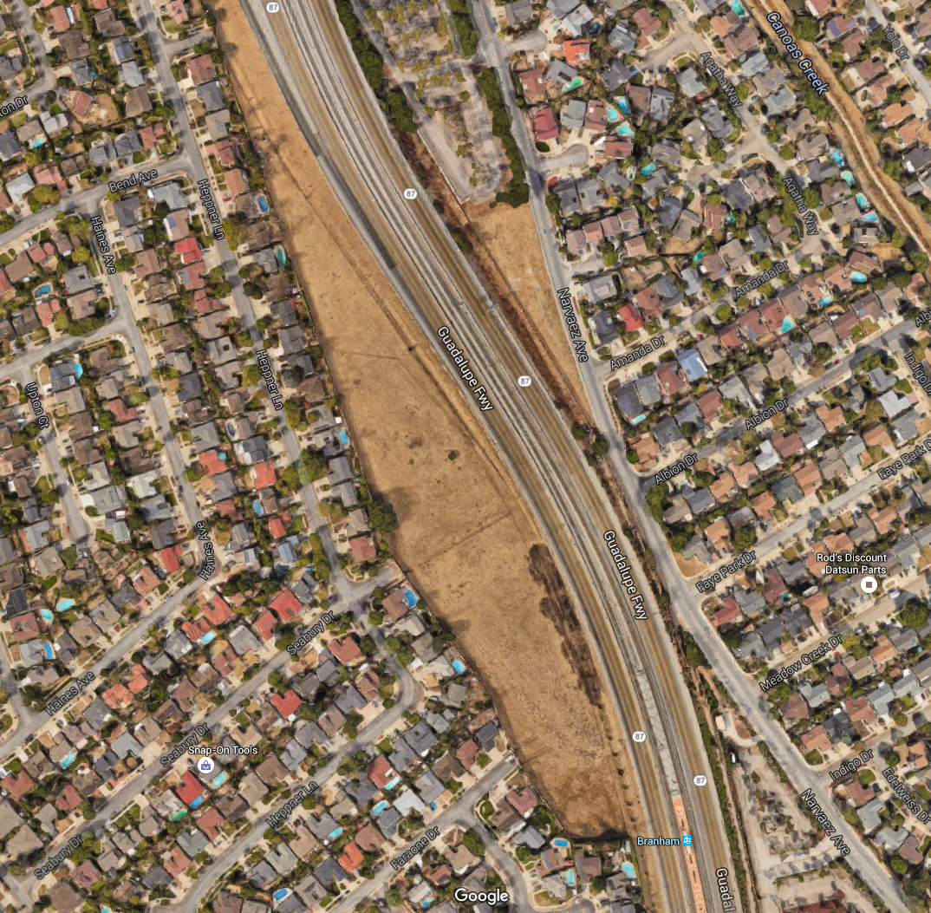
PROJECT OVERVIEW:
Project location: West of Southbound Highway 87, between Capital Expressway and Branham Lane, in San Jose.
System type: Ground mounted fixed tilt
System size: 2.1 Megawatts (enough to power 215 homes)
Project saving: Saving of $7.1 Million in electricity costs over a 25 years period.
* Very low impact use of land post construction (limited to no noise, minimal lighting, and non-visible from the residential side)

Slide 3
Project’s Environmental Attributes
System Clean Renewable Electricity = 3,421,713 KWH / Year
CO2 Emissions Avoidance = 2,405 Metric Tons / Year (EPA Calculator)
What does this mean?

Slide 4
Project Site Access and Challenges

Slide 5
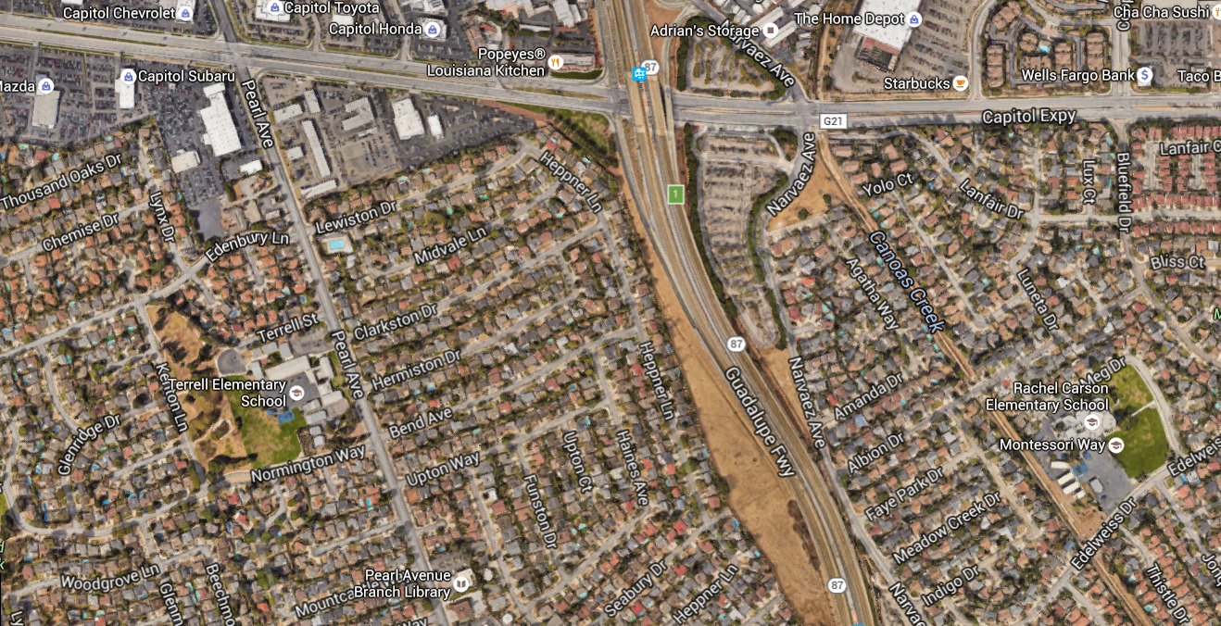
Initially Contemplated Access Points
Access Point – From Guadalupe Fwy (Not Granted by CalTrans)
Access Point – From Capitol Expy (Temporary Access)
Access Point – From Seabury Dr.
(In Progress of Pursuing Access)

Slide 6
Initial Project Site Access Points by Priority
Guadalupe/87 Freeway -Caltrans
a. Geotechnical Engineering Survey Access –Approved
b. Construction Phase Access –Not Approved
c. Maintenance & Operations Access –Not Approved
Capitol Expressway
a. Existing Improvised Access with limitations
b. No Permanent Access from Capital Expressway (No Driveway)
c. Access for ~80% of Project’s Construction Material & Equipment
Sound-wall at Seabury Drive
a. Access for Remaining 20% of Construction Activities (~8 Weeks)
b. Access for Post-Construction (O&M, Emergency Response Vehicles, PG&E)
c. Lockable Sound Attenuating Gates (Maintained Lock)

Slide 7
Project photos, as of July 8, 2016

Slide 8
With Sound-Wall Gate at Seabury Dr.
Seabury Dr. Construction Access:
Minimal Number of Delivery Trucks
2-3 tractor trailers for electrical switch gear (one time)
3 cement truck for electrical equipment pad and fence post (one time)
Truck for site services (1 truck/week for 8 weeks)
Light trucks (construction crew and tools, 8 weeks)
Work hours: 7AM – 5PM, M – F
Seabury Dr. After Construction Access:
Solar PV System Service Vehicle 2-4 times per year.
Emergency Response Vehicles
PG&E
County of Santa Clara Inspections (Property Owner)

Slide 9
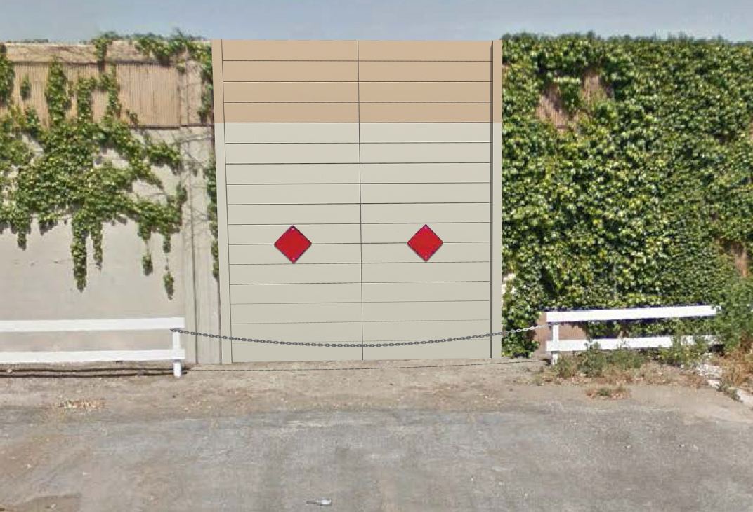
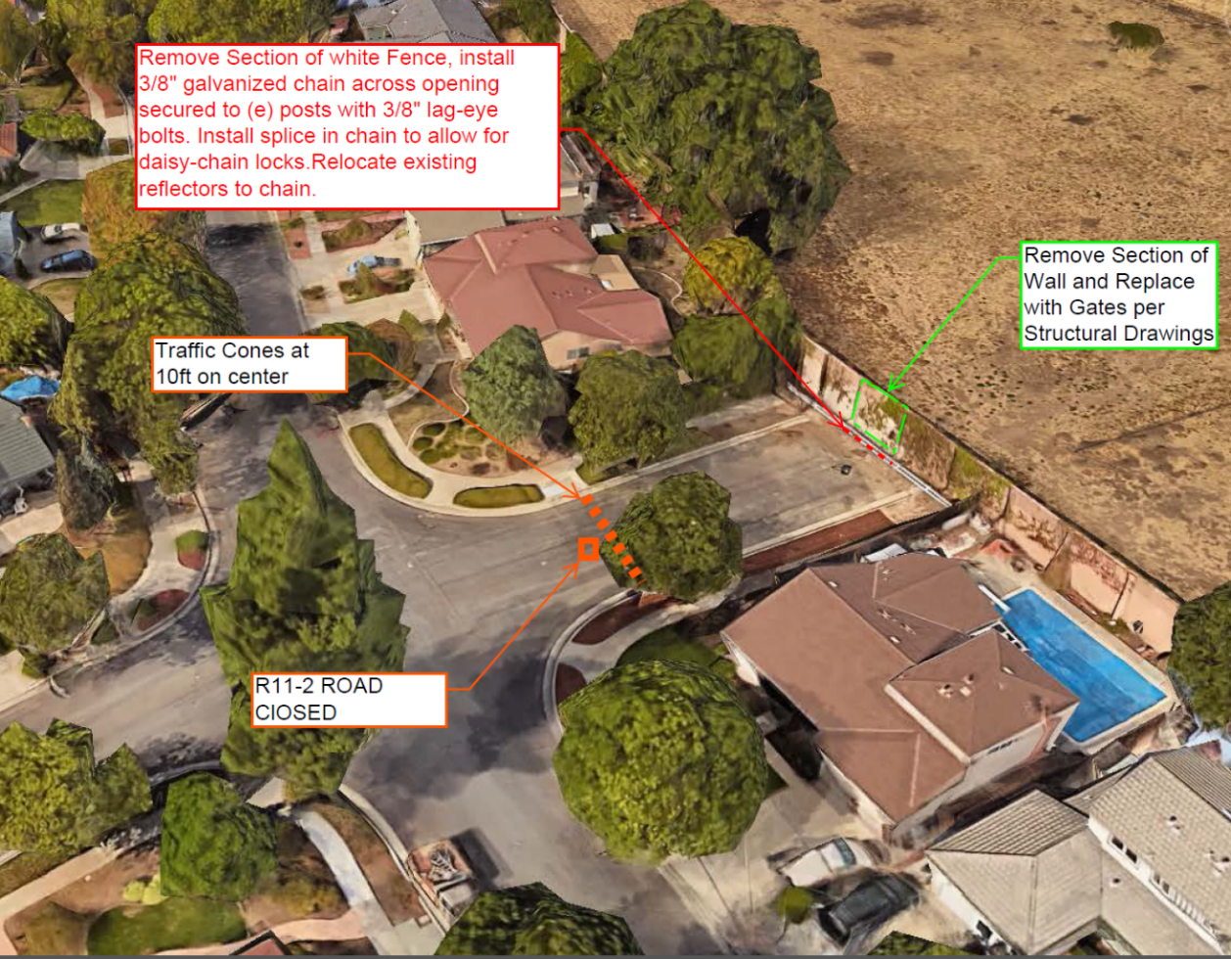
SITE ACCESS PREPARATION:
Sound-wall Panel Removal Duration: 2 days.
Gate Fabrication Duration: 2-3 weeks*.
Gate Installation Duration: 3-5 days.
*A temporary fence with acoustical blankets for sound attenuation will be temporarily installed while the permanent gate is manufactured.
Gate perspective
Sound Attenuating Gate
Professionally Designed & Engineered.
Professional Acoustical Review of Proposed Sound Attenuating Gate.
Gate Renderings Created for Visualization Purposes; Actual Gate Finish May Vary.

Slide 10
POST CONSTRUCTION ACTIVITIES & TRAFFIC IMPACTS:
Limited/no noise, minimal night lighting, non-visible from the westerly residential side.
Solar PV system maintenance: 2 to 4 visits annually for solar PV system servicing/maintenance and vegetation management. Typical visit will consist of 1-2 technicians in light pickup truck or van.
NON-VISIBLE FROM THE RESIDENTIAL SIDE
TRAFFIC IMPACTS
MINIMAL
*Minimal

Slide 11
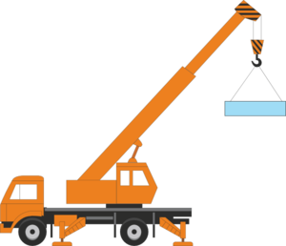
Sound-Wall Modification Alternative
Crane Large Equipment Over Sound-Wall at Seabury Drive
Pump Concrete over Sound-Wall at Seabury Drive

Slide 12
Please submit your questions/comments at this time.

Slide 13
Contact Information
County of Santa Clara
Ca Le (Project Coordinator)
Phone: (408) 993-4637
Email: Ca.Le@faf.sccgov.org
Lin Ortega (Project Manager)
Phone: (408) 993-4643
Email: Lin.Ortega@faf.sccgov.org
SunPower
Charlie Tate (Construction Manager)
Phone: (415) 373-7758
Email: Charlie.Tate@sunpower.com
Cion Trujillo (Project Manager)
Phone: (510) 260-8409
Email: Cion.Trujillo@sunpower.com

